Slide 1
Machine Learning

Slide 2
History and Evolution
Machine learning is a subset of Artificial Intelligence (AI), so let’s first understand what AI is and where machine learning fits within its wider umbrella. AI is a broad term that aims at using data to offer solutions to existing problems. It is the science and engineering of replicating, even surpassing human level intelligence in machines. That means observe or read, learn, sense, and experience.

Slide 3
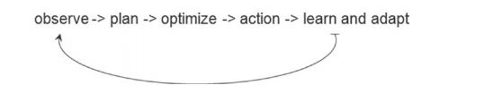
• Observe – identify patterns using the data
• Plan – find all possible solutions
• Optimize – find optimal solution from the list of possible solutions
• Action – execute the optimal solution
• Learn and Adapt – is the result giving expected result, if no adapt

Slide 4
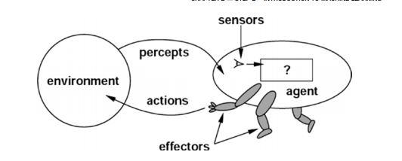
Agent Type Taxi driver
Goals Safe trip, legal, comfortable trip, maximize profits, convenient, fast
Environment Roads, traffic, signals, signage, pedestrians, customers
Percepts Speedometer, microphone, GPS, cameras, sonar, sensors
Actions Steer, accelerate, break, talk to passenger

Slide 5
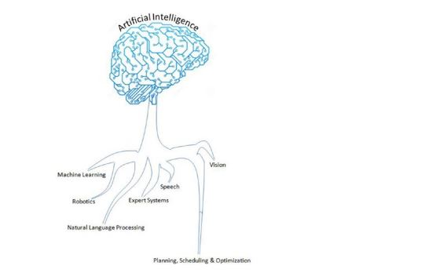

Slide 6
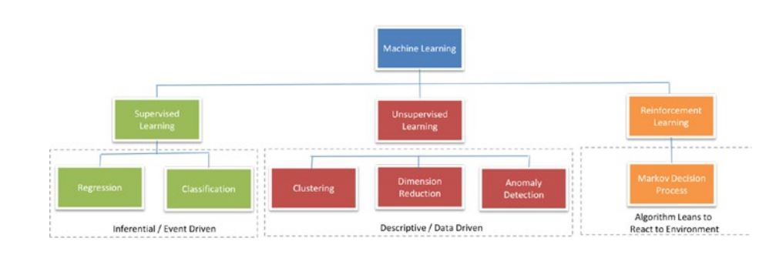

Slide 7
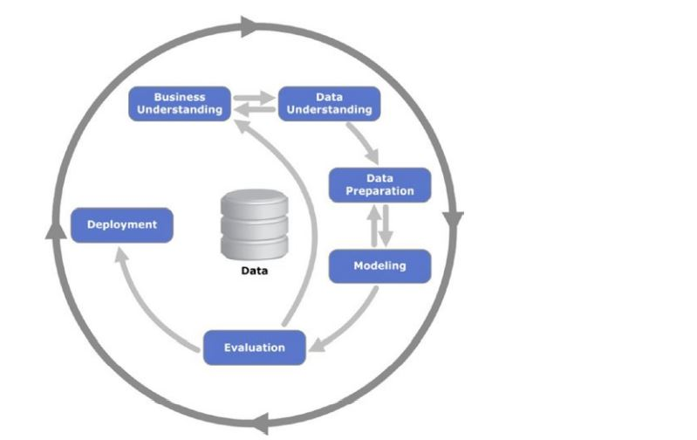

Slide 8
Phase 1: Business Understanding
As the name suggests the focus at this stage is to understand the overall project objectives and expectations from a business perspective. These objectives are converted to a data mining or machine learning problem definition and a plan of action around data requirements, business owners input, and how outcome performance evaluation metrics are designed.

Slide 9
Phase 2: Data Understanding
In this phase, initial data are collected that were identified as requirements in the previous phase. Activities are carried out to understanding data gaps or relevance of the data to the objective in hand, any data quality issues, and first insights into the data to bring out appropriate hypotheses. The outcome of this phase will be presented to the business iteratively to bring more clarity into the business understanding and project objective

Slide 10
Phase 3: Data Preparation
This phase is all about cleaning the data so that it’s ready to be used for the model building phase. Cleaning data could involve filling the known data gaps from previous steps, missing value treatments, identifying the important features, applying transformations, and creating new relevant features where applicable. This is one of the most important phases as the model’s accuracy will depend significantly on the quality of data that is being fed into the algorithm to learn the patterns.

Slide 11
Phase 4: Modeling
There are multiple machine learning algorithms available to solve a given problem. So various appropriate machine learning algorithms are applied onto the clean dataset, and their parameters are tuned to the optimal possible values. Model performance for each of the applied models is recorded.

Slide 12
Phase 5: Evaluation
In this stage a benchmarking exercise will be carried out among all the different models that were identified to have been giving high accuracy. Model will be tested against data that was not used as part of the training to evaluate its performance consistency. The results will be verified against the business requirement identified in phase 1. The subject matter experts from the business will be involved to ensure that the model results are accurate and usable as per required by the project objective.

Slide 13
Phase 6: Deployment
The key focus in this phase is the usability of the model output. So the final model signed off by the subject matter expert will be implemented, and the consumers of the model output will be trained on how to interpret or use it to take the business decisions defined

Slide 14
Fundamentals of Machine Learning
Data is the fact and figures (can also be referred as raw data) that we have available with respect to the business context. Data are made up of these two aspects:
a. Objects such as people, tree, animals, etc.
b. Attributes that were recorded for objects such as age, size, weight, cost, etc.
When we measure the attributes of an object, we obtain a value that varies between objects. For example, if we consider individual plants in a garden as objects, and the attribute ‘height' will vary between them. Correspondingly different attributes vary between objects, so attributes are more collectively known as variables.

Slide 15
Continuous or quantitative:
variables can take any positive or negative numerical value between a large range. Retail sales amount, insurance claims amounts are examples for continuous variables that can take any number within large ranges. These types of variables are also generally known as numerical variables
Discrete or qualitative:
variables can take only particular values: retail store location area, state, city are examples for discrete variables as it can take only one particular value for a store (here store is our object). These types of variables are also known as categorical variables.

Slide 16
Nominal Scale of Measurement
Data are measured at the nominal level when each case is classified into one of a number of discrete categories. This is also called categorical, that is, used only for classification. As mean is not meaningful, all that we can do is to count the number of occurrences of each type and compute the proportion (number of occurrences of each type / total occurrences).
Variable Name Example Measurement Values
Color Red, Green, Yellow, etc.
Gender Female, Male
Football Players Jersey
Number 1, 2, 3, 4, 5, etc.

Slide 17
Ordinal Scale of Measurement
Data are measured on an ordinal scale if the categories imply order. The difference between ranks is consistent in direction and authority, but not magnitude.
Variable Name Measurement Values
Military rank Second Lieutenant, First Lieutenant, Captain, Major, Lieutenant Colonel, Colonel, etc.
Clothing size Small, Medium, Large, Extra Large. Etc.
Class rank in an exam 1,2,3,4,5, etc.

Slide 18
Interval Scale of Measurement
Variable Name Example Measurement Values
Temperature 10, 20, 30, 40, etc.
IQ rating 85 - 114, 115 - 129, 130 - 144, 145 159,
Ratio Scale of Measurement Data measured on a ratio scale have differences that are meaningful, and relate to some true zero point.
Variable Name Example Measurement Values Weight 10, 20, 30, 40, 50, 60, etc. Height 5, 6, 7, 8, 9, etc. Age 1, 2, 3, 4, 5, 6, 7, etc

Slide 19
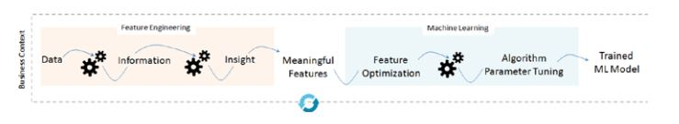
Feature Engineering
The output or the prediction quality of any machine learning algorithm depends predominantly on the quality of input being passed. The process of creating appropriate data features by applying business context is called feature engineering, and it is one of the most important aspects of building efficient machine learning systems. Business context here means the expression of the business problem that we are trying to address, why we are trying to solve it, and what is the expected outcome. So let’s understand the fundamentals of feature engineering before proceeding to different types of machine learning algorithms.

Slide 20
Data from different sources “as-is” is the raw data and when we apply business logic to process the raw data, the outcome is information (processed data). Further insight is derived from information. The process of converting raw data into information into insight with a business context to address a particular business problem is an important aspect of feature engineering.
The output of feature engineering is a clean and meaningful set of features that can be consumed by algorithms to identify patterns and build a machine learning model, which can further be applied on unseen data to predict the possible outcome. In order to have an efficient machine learning system, often feature optimization is carried out to reduce the feature dimension and retain only the important/meaningful features that will reduce the computation time and improve prediction performance. Note that machine learning model building is an iterative process.

Slide 21
Dealing with Missing Data
• Delete: You could simply delete the rows containing missing values. This technique is more suitable and effective when the number of missing value rows count is insignificant (say < 5%) compare to the overall record count. You can achieve this using Panda's dropna() function.
• Replace with summary: This is probably the most commonly used imputation technique. Summarization here is the mean, mode, or median for a respective column. For continuous or quantitative variables, either mean/average or mode or median value of the respective column can be used to replace the missing values. Whereas for categorical or qualitative variables, the mode (most frequent) summation technique works better. You can achieve this using Panda's fillna() function

Slide 22
• Random replace:
You can also replace the missing values with a randomly picked value from the respective column. This technique would be appropriate where the missing values row count is insignificant.
• Using predictive model:
This is an advanced technique. Here you can train a regression model for continuous variables and classification model for categorical variables with the available data and use the model to predict the missing values.

Slide 23
Handling Categorical Data
Most of the machine’s learning libraries are designed to work well with numerical variables. So categorical variables in their original form of text description can’t be directly used for model building. Let’s learn some of the common methods of handling categorical data based on their number of levels.

Slide 24
Create dummy variable:
This is a Boolean variable that indicates the presence of a category with the value 1 and 0 for absence. You should create k-1 dummy variables, where k is the number of levels. Scikit-learn provides a useful function ‘One Hot Encoder’ to create a dummy variable for a given categorical variable.

Slide 25
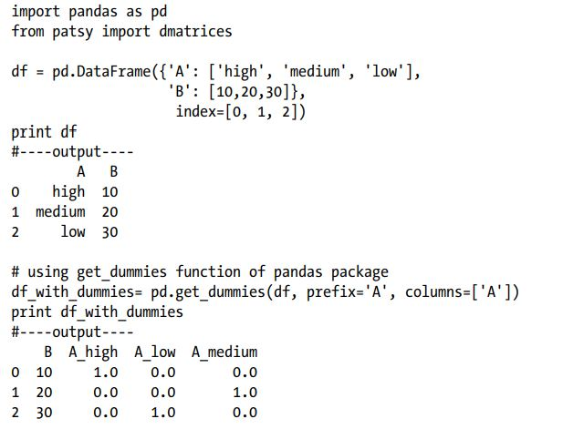

Slide 26
Convert to number:
Another simple method is to represent the text description of each level with a number by using the ‘Label Encoder’ function of Scikit-learn. If the number of levels are high (example zip code, state, etc.), then you apply the business logic to combine levels to groups. For example zip code or state can be combined to regions; however, in this method there is a risk of losing critical information. Another method is to combine categories based on similar frequency (new category can be high, medium, low).

Slide 27
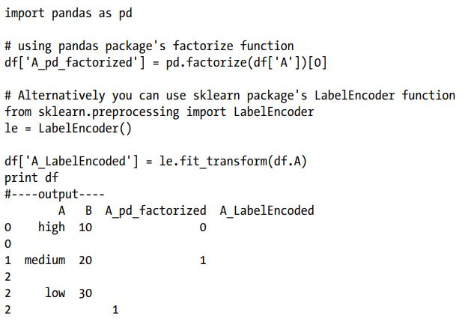

Slide 28
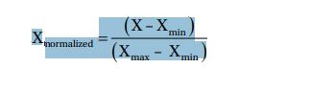
Normalizing Data
A unit or scale of measurement for different variables varies, so an analysis with the raw measurement could be artificially skewed toward the variables with higher absolute values. Bringing all the different types of variable units in the same order of magnitude thus eliminates the potential outlier measurements that would misrepresent the finding and negatively affect the accuracy of the conclusion. Two broadly used methods for rescaling data are normalization and standardization. Normalizing data can be achieved by Min-Max scaling; the formula is given below, which will scale all numeric values in the range 0 to 1.
Note Ensure you remove extreme outliers before applying the above technique as it can skew the normal values in your data to a small interval.

Slide 29
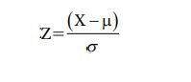
The standardization technique will transform the variables to have a zero mean and standard deviation of one. The formula for standardization is given below and the outcome is commonly known as z-scores.
Where μ is the mean and σ is the standard deviation. Standardization has often been the preferred method for various analysis as it tells us where each data point lies within its distribution and a rough indication of outliers.

Slide 30
Feature Construction or Generation
Machine learning algorithms give best results only when we provide it the best possible features that structure the underlying form of the problem that you are trying to address. Often these features have to be manually created by spending a lot of time with actual raw data and trying to understand its relationship with all other data that you have collected to address a business problem. It means thinking about aggregating, splitting, or combining features to create new features, or decomposing features. Often this part is talked about as an art form and is the key differentiator in competitive machine learning. Feature construction is manual, slow, and requires subject-matter expert intervention heavily in order to create rich features that can be exposed to predictive modeling algorithms to produce best results.

Slide 31
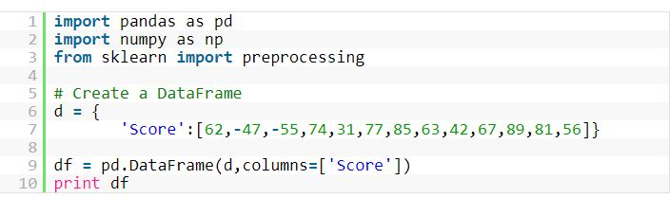

Slide 32
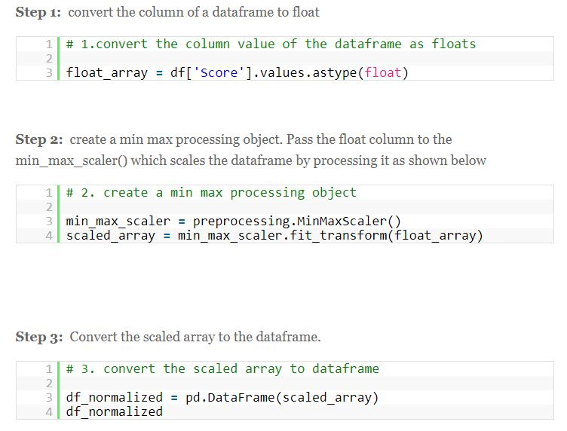

Slide 33
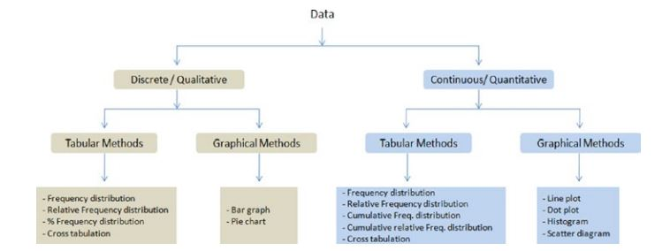

Slide 34
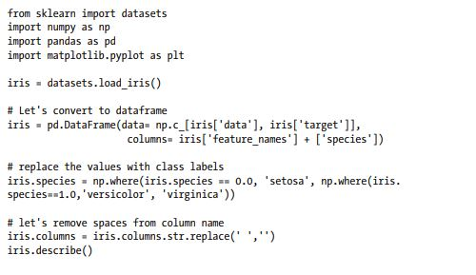
Univariate Analysis

Slide 35
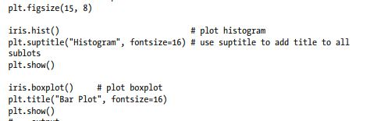

Slide 36
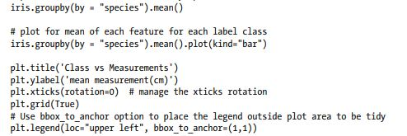
Multivariate Analysis

Slide 37
Correlation Matrix
The correlation function uses Pearson correlation coefficient, which results in a number between -1 to 1. A strong negative relationship is indicated by a coefficient closer to -1 and a strong positive correlation is indicated by a coefficient toward

Slide 38
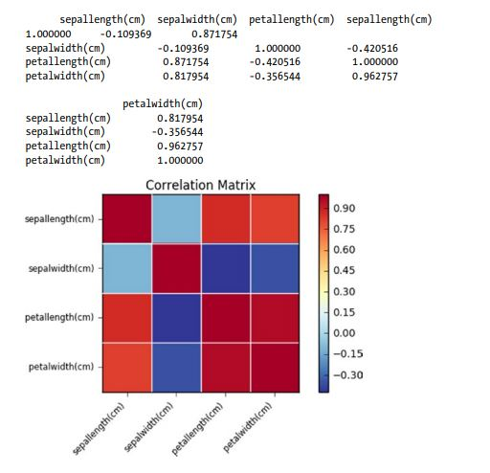
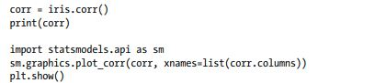

Slide 39
What is Supervised Learning?
Supervised Learning is the process of making an algorithm to learn to map an input to a particular output. This is achieved using the labelled datasets that you have collected. If the mapping is correct, the algorithm has successfully learned. Else, you make the necessary changes to the algorithm so that it can learn correctly. Supervised Learning algorithms can help make predictions for new unseen data that we obtain later in the future.
This is similar to a teacher-student scenario. There is a teacher who guides the student to learn from books and other materials. The student is then tested and if correct, the student passes. Else, the teacher tunes the student and makes the student learn from the mistakes that he or she had made in the past. That is the basic principle of Supervised Learning.

Slide 40
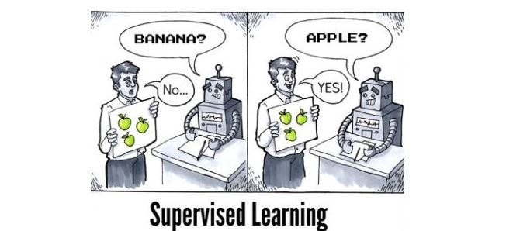

Slide 41
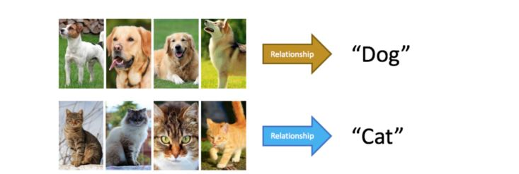

Slide 42
Types of Supervised Learning
Supervised Learning has been broadly classified into 2 types.
Regression
Classification
Regression is the kind of Supervised Learning that learns from the Labelled Datasets and is then able to predict a continuous-valued output for the new data given to the algorithm. It is used whenever the output required is a number such as money or height etc. Some popular Supervised

Slide 43
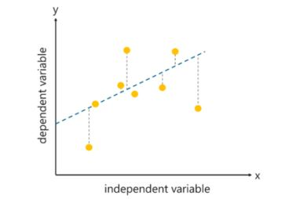
Linear Regression
This algorithm assumes that there is a linear relationship between the 2 variables, Input (X) and Output (Y), of the data it has learnt from. The Input variable is called the Independent Variable and the Output variable is called the Dependent Variable. When unseen data is passed to the algorithm, it uses the function, calculates and maps the input to a continuous value for the output

Slide 44
As such, linear regression was developed in the field of statistics and is studied as a model for understanding the relationship between input and output numerical variables, but has been borrowed by machine learning. It is both a statistical algorithm and a machine learning algorithm.
Next, let’s review some of the common names used to refer to a linear regression model.
Linear Regression Model Representation
attractive model because the representation is so simple.
The representation is a linear equation that combines a specific set of input values (x) the solution to which is the predicted output for that set of input values (y). As such, both the input values (x) and the output value are numeric.
The linear equation assigns one scale factor to each input value or column, called a coefficient and represented by the capital Greek letter Beta (B). One additional coefficient is also added, giving the line an additional degree of freedom (e.g. moving up and down on a two-dimensional plot) and is often called the intercept or the bias coefficient.
For example, in a simple regression problem (a single x and a single y), the form of the model would be:
y = B0 + B1*x
In higher dimensions when we have more than one input (x), the line is called a plane or a hyper-plane. The representation therefore is the form of the equation and the specific values used for the coefficients (e.g. B0 and B1 in the above example)

Slide 45
Simple Linear Regression
With simple linear regression when we have a single input, we can use statistics to estimate the coefficients.
This requires that you calculate statistical properties from the data such as means, standard deviations, correlations and covariance. All of the data must be available to traverse and calculate statistics.

Slide 46
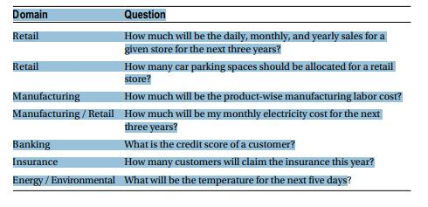

Slide 47
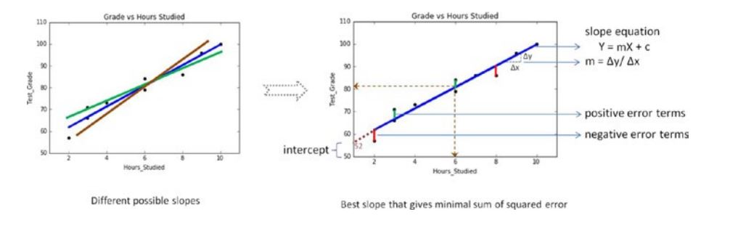
Fitting a Slope Let’s try to fit a slope line through all the points such that the error or residual, that is, the distance of line from each point is the best possible minimal.

Slide 48
The error could be positive or negative based on its location from the slope, because of which if we take a simple sum of all the errors, it will be zero. So we should square the error to get rid of negativity and then sum the squared error. Hence, the slope is also referred to as least squares line
• The slope equation is given by Y = mX + c, where Y is the predicted value for a given x value.
• m is the change in y, divided by change in x, that is, m is the slope of the line for the x variable and it indicates the steepness at which it increases with every unit increase in x variable value.
• c is the intercept that indicates the location or point on the axis where it intersects, in the case of Figure 3-5 it is 52. Intercept is a constant that represents the variability in Y that is not explained by the X. It is the value of Y when X is zero

Slide 49
If we had multiple input attributes (e.g. x1, x2, x3, etc.) This would be called multiple linear regression. The procedure for linear regression is different and simpler than that for multiple linear regression, so it is a good place to start.
In this section we are going to create a simple linear regression model from our training data, then make predictions for our training data to get an idea of how well the model learned the relationship in the data.
With simple linear regression we want to model our data as follows:
y = B0 + B1 * x
This is a line where y is the output variable we want to predict, x is the input variable we know and B0 and B1 are coefficients that we need to estimate that move the line around.
Technically, B0 is called the intercept because it determines where the line intercepts the y-axis. In machine learning we can call this the bias, because it is added to offset all predictions that we make. The B1 term is called the slope because it defines the slope of the line or how x translates into a y value before we add our bias.

Slide 50
The goal is to find the best estimates for the coefficients to minimize the errors in predicting y from x.
Simple regression is great, because rather than having to search for values by trial and error or calculate them analytically using more advanced linear algebra, we can estimate them directly from our data.
We can start off by estimating the value for B1 as:
B1 = sum((xi-mean(x)) * (yi-mean(y))) / sum((xi – mean(x))^2)
Where mean() is the average value for the variable in our dataset. The xi and yi refer to the fact that we need to repeat these calculations across all values in our dataset and i refers to the i’th value of x or y.
We can calculate B0 using B1 and some statistics from our dataset, as follows:
B0 = mean(y) – B1 * mean(x)

Slide 51
Estimating The Slope (B1)
Let’s start with the top part of the equation, the numerator.
First we need to calculate the mean value of x and y. The mean is calculated as:
1/n * sum(x)
Where n is the number of values (5 in this case). You can use the AVERAGE() function in your spreadsheet. Let’s calculate the mean value of our x and y variables:
mean(x) = 3
mean(y) = 2.8
Now we need to calculate the error of each variable from the mean. Let’s do this with x first:
x mean(x) x - mean(x)
1 3 -2
2 3 -1
4 3 1
3 3 0
5 3 2

Slide 52
y mean(y) y - mean(y)
1 2.8 -1.8
3 2.8 0.2
3 2.8 0.2
2 2.8 -0.8
5 2.8 2.2
x - mean(x) y - mean(y) Multiplication
-2 -1.8 3.6
-1 0.2 -0.2
1 0.2 0.2
0 -0.8 0
2 2.2 4.4
x - mean(x) squared
-2 4
-1 1
1 1
0 0
2 4

Slide 53
Now we can calculate the value of our slope.
B1 = 8 / 10
B1 = 0.8
Estimating The Intercept (B0)
This is much easier as we already know the values of all of the terms involved.
B0 = mean(y) – B1 * mean(x)
or
B0 = 2.8 – 0.8 * 3
or
B0 = 0.4
Making Predictions
We now have the coefficients for our simple linear regression equation.
y = B0 + B1 * x
or
y = 0.4 + 0.8 * x
Let’s try out the model by making predictions for our training data.

Slide 54
x y predicted y
1 1 1.2
2 3 2
4 3 3.6
3 2 2.8
5 5 4.4
Estimating Error
We can calculate a error for our predictions called the Root Mean Squared Error or RMSE.
RMSE = sqrt( sum( (pi – yi)^2 )/n )
Where sqrt() is the square root function, p is the predicted value and y is the actual value, i is the index for a specific instance, n is the number of predictions, because we must calculate the error across all predicted values.
First we must calculate the difference between each model prediction and the actual y values.

Slide 55
pred-y y error
1.2 1 0.2
2 3 -1
3.6 3 0.6
2.8 2 0.8
4.4 5 -0.6
The sum of these errors is 2.4 units, dividing by n and taking the square root gives us:
RMSE = 0.692
Or, each prediction is on average wrong by about 0.692 units.
error squared error
0.2 0.04
-1 1
0.6 0.36
0.8 0.64
-0.6 0.36

Slide 56
Simple linear regression is the simplest form of regression and the most studied. There is a shortcut that you can use to quickly estimate the values for B0 and B1.
Really it is a shortcut for calculating B1. The calculation of B1 can be re-written as:
B1 = corr(x, y) * stdev(y) / stdev(x)
Where corr(x) is the Correlation between x and y an stdev() is the calculation of the standard deviation for a variable.
Correlation (also known as Pearson’s correlation coefficient is a measure of how related two variables are in the range of -1 to 1. A value of 1 indicates that the two variables are perfectly positively correlated, they both move in the same direction and a value of -1 indicates that they are perfectly negatively correlated, when one moves the other moves in the other direction.
Standard deviation is a measure of how much on average the data is spread out from the mean.
You can use the function PEARSON() in your spreadsheet to calculate the correlation of x and y as 0.852 (highly correlated) and the function STDEV() to calculate the standard deviation of x as 1.5811 and y as 1.4832.
Plugging these values in we have:
B1 = 0.852 * 1.4832 / 1.5811
B1 = 0.799

Slide 57
2. Ordinary Least Squares
When we have more than one input we can use Ordinary Least Squares to estimate the values of the coefficients.
The OLS procedure seeks to minimize the sum of the squared residuals. This means that given a regression line through the data we calculate the distance from each data point to the regression line, square it, and sum all of the squared errors together. This is the quantity that ordinary least squares seeks to minimize.
This approach treats the data as a matrix and uses linear algebra operations to estimate the optimal values for the coefficients. It means that all of the data must be available and you must have enough memory to fit the data and perform matrix operations.

Slide 58
R-squared : the coefficient of determination. It is the proportion of the variance in the dependent variable that is predictable/explained
Adj. R-squared : Adjusted R-squared is the modified form of R-squared adjusted for the number of independent variables in the model. Value of adj. R-squared increases, when we include extra variables which actually improve the model.
F-statistic : the ratio of mean squared error of the model to the mean squared error of residuals. It determines the overall significance of the model.
coef : the coefficients of the independent variables and the constant term in the equation.
t : the value of t-statistic. It is the ratio of the difference between the estimated and hypothesised value of a parameter, to the standard error

Slide 59
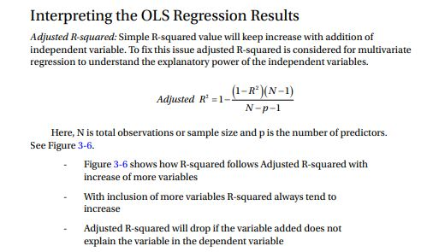

Slide 60
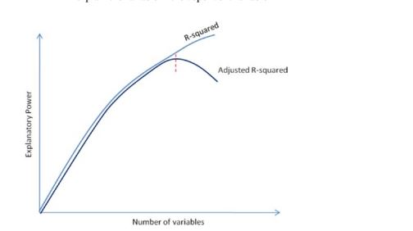

Slide 61
Coefficient: These are the individual coefficients for respective independent variables. It can be either a positive or negative number, which indicates that an increase in every unit of that independent variable will have a positive or negative impact on the dependent variable value
Standard error: This is the average distance of the respective independent observed values from the regression line. The smaller values show that the model fitting is good.
Durbin-Watson: It’s one of the common statistics used to determine the existence of multicollinearity, which means two or more independent variables used in the multivariate regression model are highly correlated. The Durbin-Watson statistics are always between the number 0 and 4. A value around 2 is ideal (range of 1.5 to 2.5 is relatively normal), and it means that there is no autocorrelation between the variables used in the model

Slide 62
Confidence interval: This is the coefficient to calculate 95% confidence interval for the independent variable’s slope.
. t and p-value: p-value is one of the import statistics. In order to get a better understanding we’ll have to understand the concept of hypothesis testing and normal distribution.

Slide 63
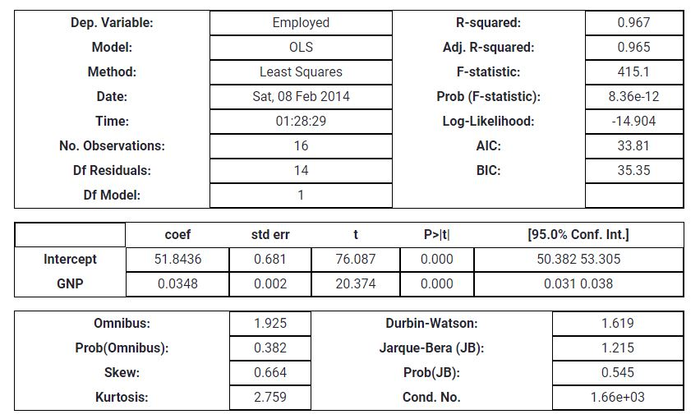

Slide 64
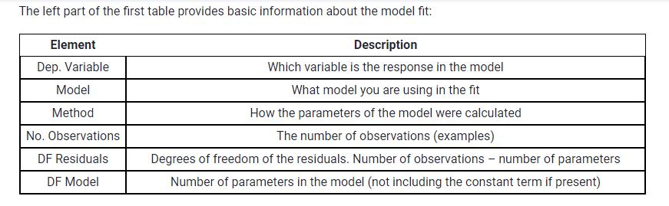

Slide 65
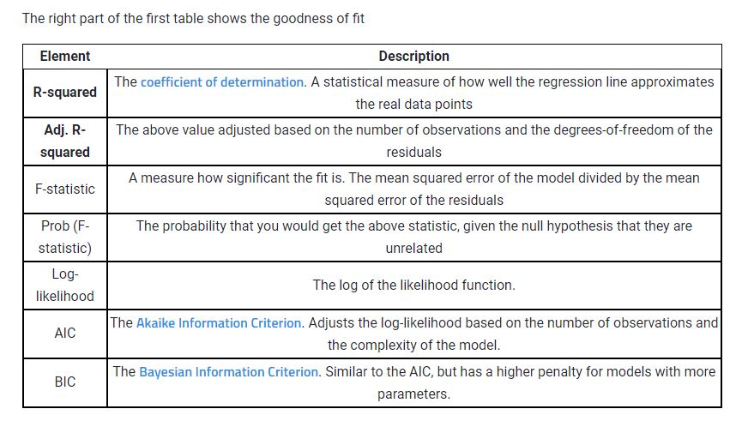

Slide 66
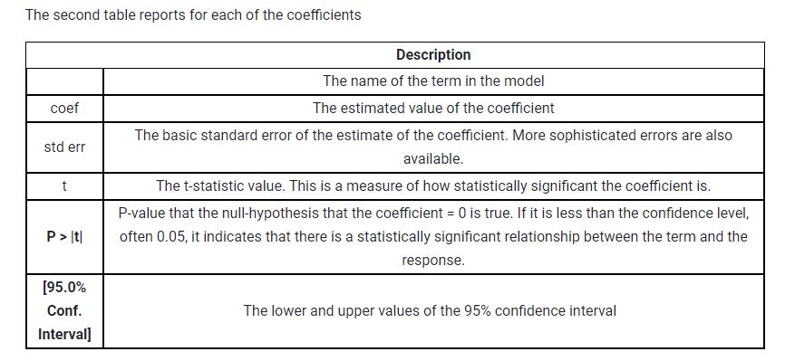

Slide 67
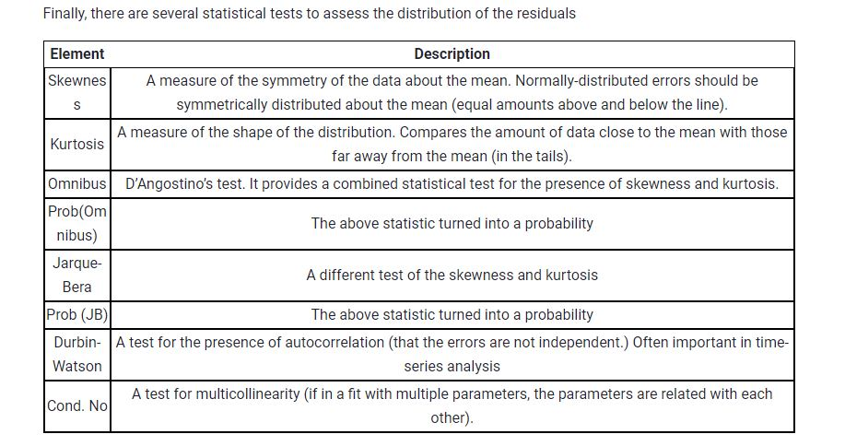

Slide 68
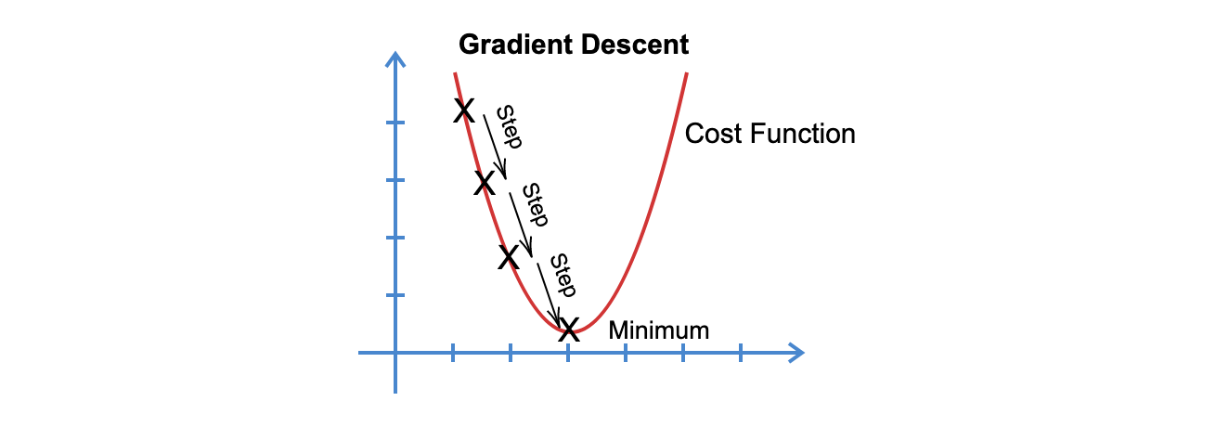
Gradient Descent
is an optimization algorithm in machine learning used to minimize a function by iteratively moving towards the minimum value of the function.
We basically use this algorithm when we have to find the least possible values that can satisfy a given cost function. In machine learning, more often that not we try to minimize loss functions (like Mean Squared Error). By minimizing the loss function , we can improve our model, and Gradient Descent is one of the most popular algorithms used for this purpose.

Slide 69
The graph above shows how exactly a Gradient Descent algorithm works.
We first take a point in the cost function and start moving in steps towards the minimum point. The size of that step, or how quickly we have to converge to the minimum point is defined by Learning Rate. We can cover more area with higher learning rate but at the risk of overshooting the minima. On the other hand, small steps/smaller learning rates will consume a lot of time to reach the lowest point.
Now, the direction in which algorithm has to move (towards minimum) is also important. We calculate this by the use of derivatives. You must be familiar with derivatives from calculus. A derivative is basically calculated as the slope of the graph at any particular point. We get that by finding the tangent line to the graph at that point. The more steep the tangent, would mean that more steps would be needed to reach minimum point, less steep would mean lesser steps are required to reach the minimum point.

Slide 70
Cost function f(x) = x³-4x²+6
Derivative of f(x) [x_derivative], f’(x) = 3x²-8x (This will give the slope of any point x along f(x) )
Start with any value of x. Lets say 0.5 and learning_rate = 0.05
Iterate over a number of times and keep calculating value of x.
x = x – (x_derivative * learning_rate)
Notice the Negative Sign, this is so that we keep moving towards the minimum point and not the other way.
x = 0.5 – (-3.25*0.05) = 0.6625
Use x = 0.6625 in second iteration
x = 0.6625+(3.983*0.05) = 0.86165
and so on until we stop seeing any change in the value of x.
The number of iterations can be fixed and given by the user. Or, if you have a precision in mind (~0.001). You can stop calculating once you reach this value of precision.

Slide 71
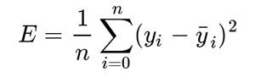
Loss Function
The loss is the error in our predicted value of m and c. Our goal is to minimize this error to obtain the most accurate value of m and c. We will use the Mean Squared Error function to calculate the loss. There are three steps in this function:
Find the difference between the actual y and predicted y value(y = mx + c), for a given x.
Square this difference.
Find the mean of the squares for every value in X.

Slide 72
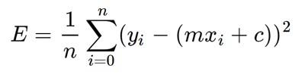
Imagine a valley and a person with no sense of direction who wants to get to the bottom of the valley. He goes down the slope and takes large steps when the slope is steep and small steps when the slope is less steep. He decides his next position based on his current position and stops when he gets to the bottom of the valley which was his goal. Let’s try applying gradient descent to m and c and approach it step by step:
Initially let m = 0 and c = 0. Let L be our learning rate. This controls how much the value of m changes with each step. L could be a small value like 0.0001 for good accuracy.
Calculate the partial derivative of the loss function with respect to m, and plug in the current values of x, y, m and c in it to obtain the derivative value D.

Slide 73
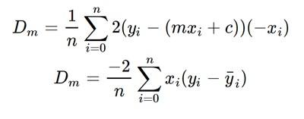
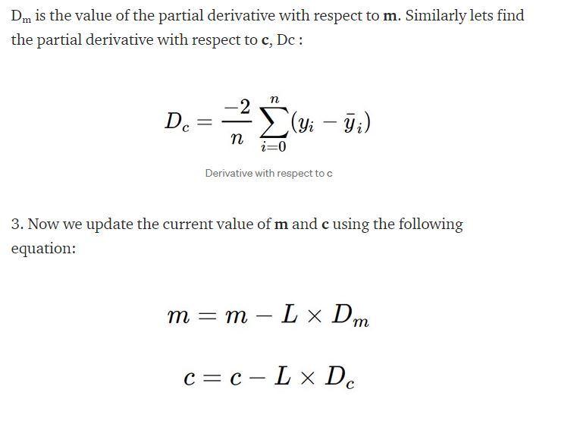

Slide 74
4. We repeat this process until our loss function is a very small value or ideally 0 (which means 0 error or 100% accuracy). The value of m and c that we are left with now will be the optimum values.
Now going back to our analogy, m can be considered the current position of the person. D is equivalent to the steepness of the slope and L can be the speed with which he moves. Now the new value of m that we calculate using the above equation will be his next position, and L×D will be the size of the steps he will take. When the slope is more steep (D is more) he takes longer steps and when it is less steep (D is less), he takes smaller steps. Finally he arrives at the bottom of the valley which corresponds to our loss = 0. Now with the optimum value of m and c our model is ready to make predictions !

Slide 75
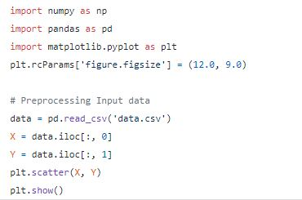
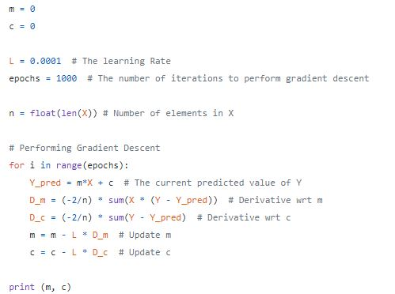

Slide 76
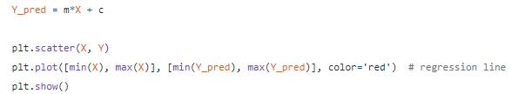

Slide 77
Problem Statement
A real state agents want the help to predict the house price for regions in the USA. He gave you the dataset to work on and you decided to use Linear Regressioon Model. Create a model which will help him to estimate of what the house would sell for.
Dataset contains 7 columns and 5000 rows with CSV extension. The data contains the following columns :
'Avg. Area Income': Avg. Income of householder of the city house is located in.
'Avg. Area House Age': Avg. Age of Houses in same city.
'Avg. Area Number of Rooms': Avg. Number of Rooms for Houses in same city.
'Avg. Area Number of Bedrooms': Avg. Number of Bedrooms for Houses in same city.
'Area Population': Population of city.
'Price': Price that the house sold at.
'Address': Address of the houses.

Slide 78
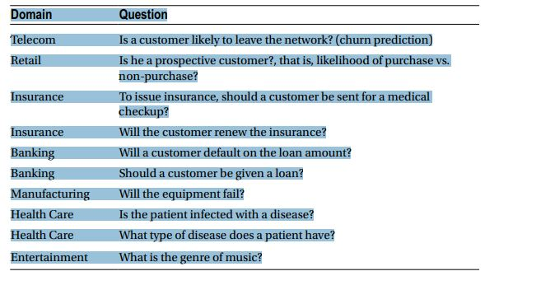
Supervised Learning – Classification
The answers to these questions are a discrete class. The number of level or class can vary from a minimum of two (example: true or false, yes or no) to multiclass. In machine learning, classification deals with identifying the probability of a new object being a member of a class or set. The classifiers are the algorithms that map the input data (also called features) to categories.

Slide 79
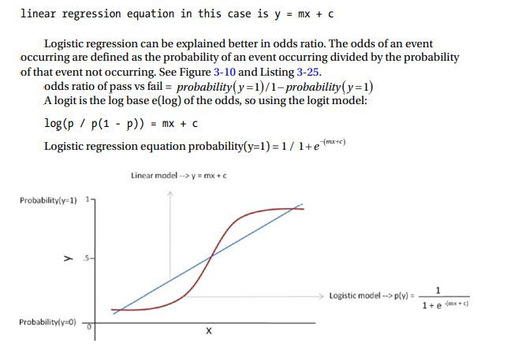
The outcome that we are expecting is either 1 or 0, and the issue with linear regression is that it can give values large than 1 or less than 0. In the above plot we can see that linear regression is not able to draw boundaries to classify observations. The solution to this is to introduce sigmoid or Logit function (which takes a S shape) to the regression equation. The fundamental idea here is that the hypothesis will use the linear approximation, then map it with a logistic function for binary prediction

Slide 80
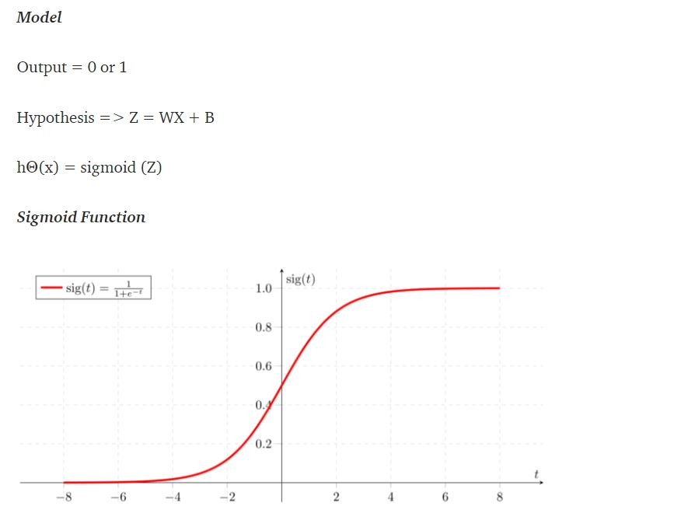

Slide 81
Let’s say we have a model that can predict whether a person is male or female based on their height (completely fictitious). Given a height of 150cm is the person male or female.
We have learned the coefficients of b0 = -100 and b1 = 0.6. Using the equation above we can calculate the probability of male given a height of 150cm or more formally P(male|height=150). We will use EXP() for e, because that is what you can use if you type this example into your spreadsheet:
y = e^(b0 + b1*X) / (1 + e^(b0 + b1*X))
y = exp(-100 + 0.6*150) / (1 + EXP(-100 + 0.6*X))
y = 0.0000453978687
Or a probability of near zero that the person is a male.

Slide 82
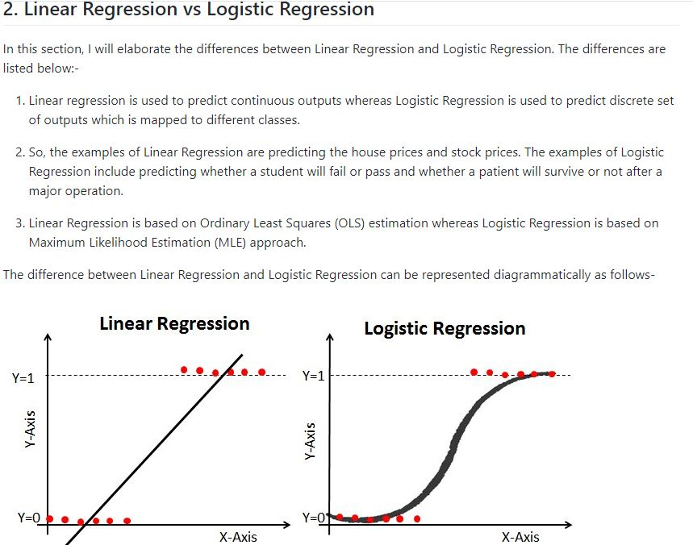

Slide 83
Assumptions of Logistic Regression
Logistic Regression does not require the key assumptions of linear regression and generalized linear models. In particular, it does not require the following key assumptions of linear regression:-
Logistic Regression does not follow the assumption of linearity. It does not require a linear relationship between the independent and dependent variables.
The residuals or error terms do not need to follow the normal distribution.
Logistic Regression does not require the assumption of homoscedasticity. Homoscedasticity means all the variables in the model have same variance. So, in Logistic Regression model, the variables may have different variance.
The dependent variable in Logistic Regression is not measured on an interval or ratio scale.
The Logistic Regression model requires several key assumptions. These are as follows:-
Logistic Regression model requires the dependent variable to be binary, multinomial or ordinal in nature.
It requires the observations to be independent of each other. So, the observations should not come from repeated measurements.
Logistic Regression algorithm requires little or no multicollinearity among the independent variables. It means that the independent variables should not be too highly correlated with each other.
Logistic Regression model assumes linearity of independent variables and log odds.
The success of Logistic Regression model depends on the sample sizes. Typically, it requires a large sample size to achieve the high accuracy.

Slide 84
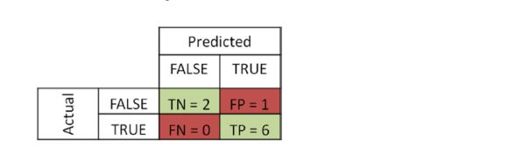
Evaluating a Classification Model Performance
• True Negatives (TN): Actual FALSE, which was predicted as FALSE
• False Positives (FP): Actual FALSE, which was predicted as TRUE (Type I error)
• False Negatives (FN): Actual TRUE, which was predicted as FALSE (Type II error)
• True Positives (TP): Actual TRUE, which was predicted as TRUE
Recall = TP/TP+FN

Slide 85
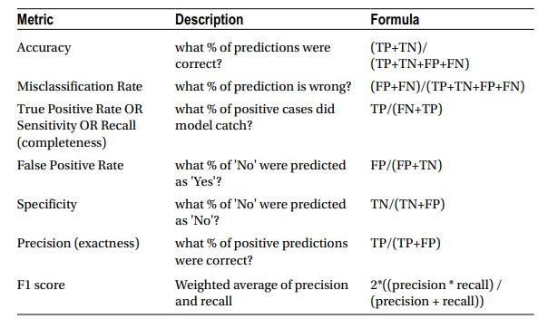

Slide 86
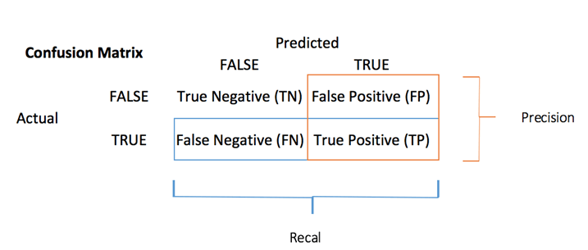
The confusion matrix visualizes the accuracy of a classifier by comparing the actual and predicted classes. The binary confusion matrix is composed of squares:

Slide 87
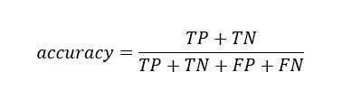
TP: True Positive: Predicted values correctly predicted as actual positive
FP: Predicted values incorrectly predicted an actual positive. i.e., Negative values predicted as positive
FN: False Negative: Positive values predicted as negative
TN: True Negative: Predicted values correctly predicted as an actual negative

Slide 88
Example of Confusion Matrix:
Confusion Matrix is a useful machine learning method which allows you to measure Recall, Precision, Accuracy, and AUC-ROC curve. Below given is an example to know the terms True Positive, True Negative, False Negative, and True Negative.
True Positive:
You projected positive and its turn out to be true. For example, you had predicted that France would win the world cup, and it won.
True Negative:
When you predicted negative, and it's true. You had predicted that England would not win and it lost.
False Positive:
Your prediction is positive, and it is false.
You had predicted that England would win, but it lost.
False Negative:
Your prediction is negative, and result it is also false.
You had predicted that France would not win, but it won.
You should remember that we describe predicted values as either True or False or Positive and Negative.

Slide 89
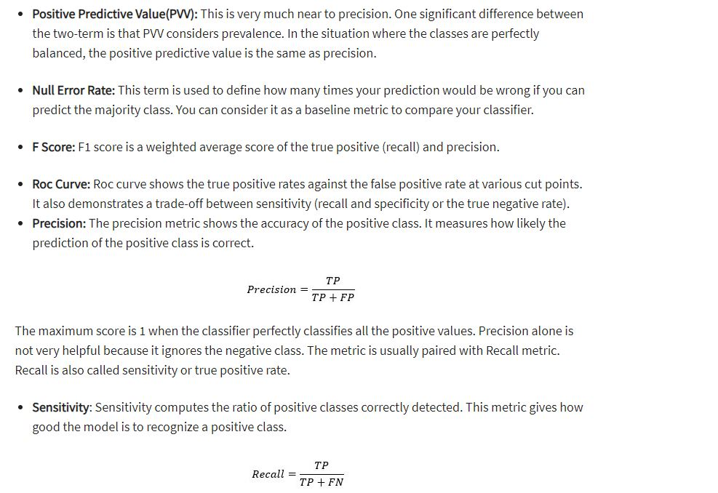

Slide 90
from sklearn.metrics import precision_recall_fscore_support as score
predicted = [1,2,3,4,5,1,2,1,1,4,5]
y_test = [1,2,3,4,5,1,2,1,1,4,1]
precision, recall, fscore, support = score(y_test,predicted)
print('precision: {}'.format(precision))
print('recall: {}'.format(recall))
print('fscore: {}'.format(fscore))
print('support: {}'.format(support))

Slide 91
Problem Statement
A real state agents want the help to predict the house price for regions in the USA. He gave you the dataset to work on and you decided to use Linear Regressioon Model. Create a model which will help him to estimate of what the house would sell for.
Dataset contains 7 columns and 5000 rows with CSV extension. The data contains the following columns :
'Avg. Area Income': Avg. Income of householder of the city house is located in.
'Avg. Area House Age': Avg. Age of Houses in same city.
'Avg. Area Number of Rooms': Avg. Number of Rooms for Houses in same city.
'Avg. Area Number of Bedrooms': Avg. Number of Bedrooms for Houses in same city.
'Area Population': Population of city.
'Price': Price that the house sold at.
'Address': Address of the houses.

Slide 92
Project Goal
To experiment with a real-world application of logistic regression to further my understanding of machine learning.
Question Answered by Model
What is the (log odds of) probability that a pixel containing R, G, B values represents the skin of human face?
Why (Binary) Logistic Regression?
Binary classification problems are perfect for logistic regression because logistic regression allows us to predict the probability of a discrete outcome (here, a pixel containing or not containing skin) based on a set of independent features (here, R, G, B values) related to that outcome.
Why not linear regression? While the underlying mechanism in logistic regression is linear regression (because the log odds probability of the outcome is a linear function of the features), linear regression is best used when trying to model the linear relationship between various (discrete or continuous) features with a continuous outcome. Moreover, linear regression models aim to minimize the sum of squared errors, while logistic regression models aim to model the parameters under which our observations become most likely.

Slide 93
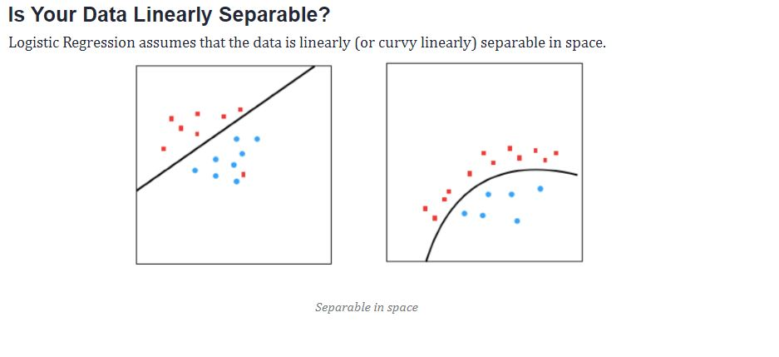

Slide 94
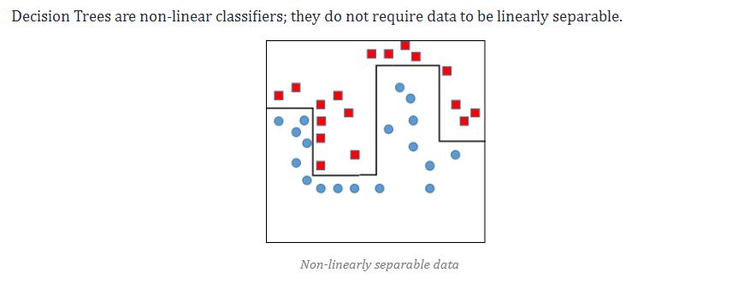

Slide 95
Linearly non - separable? | Decision Tree
Categorical Data type | Decision Tree
Continuous Data type | Logistic Regression
Skewed | Decision Tree, or give high weight to minority class in Logistic Regression
Outlier | Decision Tree, or remove outlier for Logistic Regression
Lots of Missing values | Decision Tree

Slide 96
Multiclass Logistic Regression
Logistic regression can also be used to predict the dependent or target variable with multiclass. Let’s learn multiclass prediction with iris dataset, one of the best-known databases to be found in the pattern recognition literature. The dataset contains 3 classes of 50 instances each, where each class refers to a type of iris plant. This comes as part of the scikit-learn datasets, where the third column represents the petal length, and the fourth column the petal width of the flower samples. The classes are already converted to integer labels where 0=Iris-Setosa, 1=Iris-Versicolor, 2=Iris-Virginica.

Slide 97
Decision Trees
In 1986, J. R. Quinlan published Induction of Decision Trees summarizing an approach to synthesizing decision trees using machine learning with an illustrative example dataset, where the objective is to make a decision on whether to play outside on a Saturday morning. As the name suggests, a decision tree is a tree-like structure where internal nodes represent a test on an attribute, each branch represents outcome of a test, and each leaf node represents class label, and the decision is made after computing all attributes. A path from root to leaf represents classification rules. Thus, a decision tree consists of three types of nodes.

Slide 98
Advantages:
It is very easy to understand and interpret.
The data for decision trees require minimal preparation.
They force you to find many possible outcomes of a decision.
Can be easily used with many other decision tools.
Helps you to make the best decisions and best guesses on the basis of the information you have.
Helps you to see the difference between controlled and uncontrolled events.
Helps you estimate the likely results of one decision against another.

Slide 99
Disadvantages:
Sometimes decision trees can become too complex.
The outcomes of decisions may be based mainly on your expectations. This can lead to unrealistic decision trees.
The diagrams can narrow your focus to critical decisions and objectives.

Slide 100
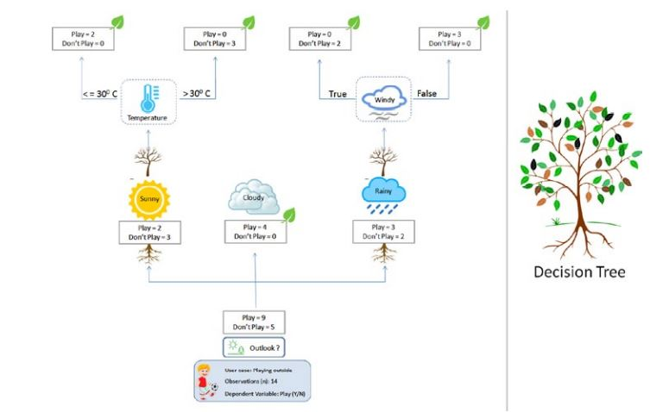

Slide 101
Below are some assumptions that we made while using decision tree:
At the beginning, we consider the whole training set as the root.
Feature values are preferred to be categorical. If the values are continuous then they are discretized prior to building the model.
On the basis of attribute values records are distributed recursively.
We use statistical methods for ordering attributes as root or the internal node.

Slide 102


Slide 103
How the Tree Splits and Grows?
• The base algorithm is known as a greedy algorithm, in which the tree is constructed in a top-down recursive divide-and-conquer manner.
• At start, all the training examples are at the root.
• Input data is partitioned recursively based on selected attributes.
• Test attributes at each node are selected on the basis of a heuristic or statistical impurity measure example, gini, or information gain (entropy)

Slide 104
• Entropy = -p log2(p) – q log2(q), where p and q represent the probability of success/failure respectively in a given node.
■ Note Default criterion is “gini” as it’s comparatively faster to compute than “entropy”; however both measures give almost identical decisions on split.

Slide 105


Slide 106



Slide 107


Slide 108


Slide 109


Slide 110


Slide 111


Slide 112

Support Vector Machine (SVM)
Vladimir N. Vapnik and Alexey Ya. Chervonenkis in 1963 proposed SVM. The key objective of SVM is to draw a hyperplane that separates the two classes optimally such that the margin is maximum between the hyperplane and the observations. Figure 3-15 illustrates that there is the possibility of different hyperplanes. However the objective of SVM is to find the one which gives us a high margin.

Slide 113
Support Vector Machine (SVM) is a relatively simple Supervised Machine Learning Algorithm used for classification and/or regression. It is more preferred for classification but is sometimes very useful for regression as well. Basically, SVM finds a hyper-plane that creates a boundary between the types of data. In 2-dimensional space, this hyper-plane is nothing but a line. In SVM, we plot each data item in the dataset in an N-dimensional space, where N is the number of features/attributes in the data. Next, find the optimal hyperplane to separate the data. So by this, you must have understood that inherently, SVM can only perform binary classification (i.e., choose between two classes). However, there are various techniques to use for multi-class problems.
Support Vector Machine for Multi-CLass Problems To perform SVM on multi-class problems, we can create a binary classifier for each class of the data. The two results of each classifier will be :
The data point belongs to that class OR
The data point does not belong to that class.
For example, in a class of fruits, to perform multi-class classification, we can create a binary classifier for each fruit. For say, the ‘mango’ class, there will be a binary classifier to predict if it IS a mango OR it is NOT a mango. The classifier with the highest score is chosen as the output of the SVM.

Slide 114


Slide 115


Slide 116


Slide 117


Slide 118


Slide 119


Slide 120


Slide 121


Slide 122


Slide 123


Slide 124
Important Parameters in Kernelized SVC ( Support Vector Classifier)
The Kernel : The kernel, is selected based on the type of data and also the type of transformation. By default, the kernel is Radial Basis Function Kernel (RBF).
Gamma : This parameter decides how far the influence of a single training example reaches during transformation, which in turn affects how tightly the decision boundaries end up surrounding points in the input space. If there is a small value of gamma, points farther apart are considered similar. So more points are grouped together and have smoother decision boundaries (may be less accurate). Larger values of gamma cause points to be closer together (may cause overfitting).
The ‘C’ parameter : This parameter controls the amount of regularization applied on the data. Large values of C mean low regularization which in turn causes the training data to fit very well (may cause overfitting). Lower values of C mean higher regularization which causes the model to be more tolerant of errors (may lead to lower accuracy).

Slide 125
When the data set is linearly inseparable or in other words, the data set is non-linear, it is recommended to use kernel functions such as RBF. For a linearly separable dataset (linear dataset) one could use linear kernel function (kernel=”linear”). Getting a good understanding of when to use kernel functions will help train the most optimal model using the SVM algorithm. We will use Sklearn Breast Cancer data set to understand SVM RBF kernel concepts in this post. The scatter plot given below represents the fact that the dataset is linearly inseparable and it may be a good idea to apply the kernel method for training the model

Slide 126
Kernel Parameter – Gamma Values
The gamma parameter defines how far the influence of a single training example reaches, with low values meaning ‘far’ and high values meaning ‘close’. The lower values of gamma result in models with lower accuracy and the same as the higher values of gamma. It is the intermediate values of gamma which gives a model with good decision boundaries. The same is shown in the plots given in fig 2.
The plots below represent decision boundaries for different values of gamma with the value of C set as 0.1 for illustration purposes. Note that as the Gamma value increases, the decision boundaries classify the points correctly. However, after a certain point (Gamma = 1.0 and onwards in the diagram below), the model accuracy decreases. It can thus be understood that the selection of appropriate values of Gamma is important. Here is the code which is used.

Slide 127


Slide 128
When gamma is very small (0.008 or 0.01), the model is too constrained and cannot capture the complexity or “shape” of the data. The region of influence of any selected support vector would include the whole training set. The resulting model will behave similarly to a linear model with a set of hyperplanes that separate the centers of a high density of any pair of two classes. Compare with the diagram in the next section where the decision boundaries for a model trained with a linear kernel is shown.
For intermediate values of gamma (0.05, 0.1, 0.5), it can see on the second plot that good models can be found.
For larger values of gamma (3.0, 7.0, 11.0) in the above plot, the radius of the area of influence of the support vectors only includes the support vector itself and no amount of regularization with C will be able to prevent overfitting.

Slide 129
Simply speaking, the C parameter is a regularization parameter used to set the tolerance of the model to allow the misclassification of data points in order to achieve lower generalization error. Higher the value of C, lesser is the tolerance and what is trained is a maximum-margin classifier. Smaller the value of C, larger is the tolerance of misclassification and what gets trained is a soft-margin classifier that generalizes better than maximum-margin classifier. The C value controls the penalty of misclassification. A large value of C would result in a higher penalty for misclassification and a smaller value of C will result in a smaller penalty of misclassification. With a larger value of C, a smaller margin will be accepted if the decision function is better at classifying all training points correctly. The model may overfit with the training dataset. A lower C will encourage a larger margin, therefore a simpler decision function, at the cost of training accuracy.

Slide 130


Slide 131
Conclusion
Here are some of the key points that is covered in this post.
Gamma and C values are key hyperparameters that can be used to train the most optimal SVM model using RBF kernel.
The gamma parameter defines how far the influence of a single training example reaches, with low values meaning ‘far’ and high values meaning ‘close’
Higher value of gamma will mean that radius of influence is limited to only support vectors. This would essentially mean that the model tries and overfit. The model accuracy lowers with the increasing value of gamma.
The lower value of gamma will mean that the data points have very high radius of influence. This would also result in model having lower accuracy.
It is the intermediate value of gamma which results in a model with optimal accuracy.
The C parameter determines how tolerant is the model towards misclassification.
Higher value of C will result in model which has very high accuracy but which may fail to generalize.
The lower value of C will result in a model with very low accuracy.

Slide 132
Pros of Kernelized SVM:
They perform very well on a range of datasets.
They are versatile : different kernel functions can be specified, or custom kernels can also be defined for specific datatypes.
They work well for both high and low dimensional data.
Cons of Kernelized SVM:
Efficiency (running time and memory usage) decreases as size of training set increases.
Needs careful normalization of input data and parameter tuning.
Does not provide direct probability estimator.
Difficult to interpret why a prediction was made.

Slide 133
knn
K-nearest neighbors (KNN) algorithm is a type of supervised ML algorithm which can be used for both classification as well as regression predictive problems. However, it is mainly used for classification predictive problems in industry. The following two properties would define KNN well −
Lazy learning algorithm − KNN is a lazy learning algorithm because it does not have a specialized training phase and uses all the data for training while classification.
Non-parametric learning algorithm − KNN is also a non-parametric learning algorithm because it doesn’t assume anything about the underlying data.

Slide 134

Advantages of KNN
1. No Training Period: KNN is called Lazy Learner (Instance based learning). It does not learn anything in the training period. It does not derive any discriminative function from the training data. In other words, there is no training period for it. It stores the training dataset and learns from it only at the time of making real time predictions. This makes the KNN algorithm much faster than other algorithms that require training e.g. SVM, Linear Regression etc. 2. Since the KNN algorithm requires no training before making predictions, new data can be added seamlessly which will not impact the accuracy of the algorithm. 3. KNN is very easy to implement. There are only two parameters required to implement KNN i.e. the value of K and the distance function (e.g. Euclidean or Manhattan etc.)

Slide 135
Working of KNN Algorithm
K-nearest neighbors (KNN) algorithm uses ‘feature similarity’ to predict the values of new datapoints which further means that the new data point will be assigned a value based on how closely it matches the points in the training set. We can understand its working with the help of following steps −
Step 1 − For implementing any algorithm, we need dataset. So during the first step of KNN, we must load the training as well as test data.
Step 2 − Next, we need to choose the value of K i.e. the nearest data points. K can be any integer.
Step 3 − For each point in the test data do the following −
3.1 − Calculate the distance between test data and each row of training data with the help of any of the method namely: Euclidean, Manhattan or Hamming distance. The most commonly used method to calculate distance is Euclidean.
3.2 − Now, based on the distance value, sort them in ascending order.
3.3 − Next, it will choose the top K rows from the sorted array.
3.4 − Now, it will assign a class to the test point based on most frequent class of these rows.
Step 4 − End

Slide 136

Let us start with a simple example. Consider the following table – it consists of the height, age and weight (target) value for 10 people. As you can see, the weight value of ID11 is missing. We need to predict the weight of this person based on their height and age.
Note: The data in this table does not represent actual values. It is merely used as an example to explain this concept.

Slide 137


Slide 138
In the above graph, the y-axis represents the height of a person (in feet) and the x-axis represents the age (in years). The points are numbered according to the ID values. The yellow point (ID 11) is our test point.
If I ask you to identify the weight of ID11 based on the plot, what would be your answer? You would likely say that since ID11 is closer to points 5 and 1, so it must have a weight similar to these IDs, probably between 72-77 kgs (weights of ID1 and ID5 from the table). That actually makes sense, but how do you think the algorithm predicts the values? We will find that out in this article.
Coming to your question, the value of k is non-parametric and a general rule of thumb in choosing the value of k is k = sqrt(N)/2, where N stands for the number of samples in your training dataset

Slide 139
As we saw above, KNN algorithm can be used for both classification and regression problems. The KNN algorithm uses ‘feature similarity’ to predict the values of any new data points. This means that the new point is assigned a value based on how closely it resembles the points in the training set. From our example, we know that ID11 has height and age similar to ID1 and ID5, so the weight would also approximately be the same.
Had it been a classification problem, we would have taken the mode as the final prediction. In this case, we have two values of weight – 72 and 77. Any guesses on how the final value will be calculated? The average of the values is taken to be the final prediction.

Slide 140


Slide 141

2. The closest k data points are selected (based on the distance). In this example, points 1, 5, 6 will be selected if the value of k is 3. We will further explore the method to select the right value of k later in this article.

Slide 142



Slide 143


4. How to choose the k factor?
The second step is to select the k value. This determines the number of neighbors we look at when we assign a value to any new observation.
In our example, for a value k = 3, the closest points are ID1, ID5 and ID6.

Slide 144


Slide 145


Slide 146
Project Overview¶
In this project, I am going to build a ITEM_BASED collabartive recommender system . In this recommender system , items will be clustered based on rating of item given by users and item will be recommends based on similar items.
ITEM-BASED recommender system
Collaborative filtering based systems use the actions of users to recommend other items. In general, they can either be user based or item based. User based collaborating filtering uses the patterns of users similar to me to recommend a product (users like me also looked at these other items). Item based collaborative filtering uses the patterns of users who browsed the same item as me to recommend me a product (users who looked at my item also looked at these other items). Item-based approach is usually prefered than user-based approach. User-based approach is often harder to scale because of the dynamic nature of users, whereas items usually don't change much, so item-based approach often can be computed offline.

Slide 147
The algorithm will categorize the items into k groups of similarity. To calculate that similarity, we will use the euclidean distance as measurement.
The algorithm works as follows:
First we initialize k points, called means, randomly.
We categorize each item to its closest mean and we update the mean’s coordinates, which are the averages of the items categorized in that mean so far.
We repeat the process for a given number of iterations and at the end, we have our clusters.

Slide 148
Machine learning algorithms can be broadly classified into two categories - supervised and unsupervised learning. There are other categories also like semi-supervised learning and reinforcement learning. But, most of the algorithms are classified as supervised or unsupervised learning. The difference between them happens because of presence of target variable. In unsupervised learning, there is no target variable. The dataset only has input variables which describe the data. This is called unsupervised learning.
K-Means clustering is the most popular unsupervised learning algorithm. It is used when we have unlabelled data which is data without defined categories or groups. The algorithm follows an easy or simple way to classify a given data set through a certain number of clusters, fixed apriori. K-Means algorithm works iteratively to assign each data point to one of K groups based on the features that are provided. Data points are clustered based on feature similarity.
There is a popular method known as elbow method which is used to determine the optimal value of K to perform the K-Means Clustering Algorithm. The basic idea behind this method is that it plots the various values of cost with changing k. As the value of K increases, there will be fewer elements in the cluster.

Slide 149


Slide 150
The advantages of K-Means are as follows:-
K-Means is a fast, robust and easier to understand.
K-Means is a relatively efficient clustering algorithm that helps to find intrinsic groups within the unlabelled dataset.
K-Means give best result when data set are distinct and well separated from each other.
Disadvantages of K-Means are listed below:-
The learning algorithm requires apriori specification of the number of cluster centres.
If there are two highly overlapping data, then K-Means will not be able to detect that there are two clusters.
The K-Means algorithm is not invariant to non-linear transformations. It fails for non-linear dataset.
The algorithm is unable to handle noisy data and outliers.
K-Means algorithm is applicable only when mean is defined. So, it fails for categorical data.

Slide 151
K MEAN
[2,3,4,10,11,12,20,25,30]
K = 2
M1=4 AND M2 = 12

Slide 152
PROBLEM
The dataset consists of Facebook pages of 10 Thai fashion and cosmetics retail sellers. The status_type behaviour variable consists of posts of a different nature (video, photos, statuses and links). It also contains engagement metrics of comments, shares and reactions. I implement K-Means clustering to find intrinsic groups within this dataset that display the same status_type behaviour.

Slide 153
Naïve bayes

Slide 154


Slide 155
The dataset is divided into two parts, namely, feature matrix and the response vector.
Feature matrix contains all the vectors(rows) of dataset in which each vector consists of the value of dependent features. In above dataset, features are ‘Outlook’, ‘Temperature’, ‘Humidity’ and ‘Windy’.
Response vector contains the value of class variable(prediction or output) for each row of feature matrix. In above dataset, the class variable name is ‘Play golf’.
Assumption:
The fundamental Naive Bayes assumption is that each feature makes an:
independent
equal
contribution to the outcome.
With relation to our dataset, this concept can be understood as:
We assume that no pair of features are dependent. For example, the temperature being ‘Hot’ has nothing to do with the humidity or the outlook being ‘Rainy’ has no effect on the winds. Hence, the features are assumed to be independent.
Secondly, each feature is given the same weight(or importance). For example, knowing only temperature and humidity alone can’t predict the outcome accuratey. None of the attributes is irrelevant and assumed to be contributing equally to the outcome.

Slide 156


Slide 157

Bayes’ Theorem finds the probability of an event occurring given the probability of another event that has already occurred. Bayes’ theorem is stated mathematically as the following equation:

Slide 158


Slide 159


Slide 160


Slide 161


Slide 162


Slide 163
You might be interested in finding out a patient’s probability of having liver disease if they are an alcoholic. “Being an alcoholic” is the test (kind of like a litmus test) for liver disease.
A could mean the event “Patient has liver disease.” Past data tells you that 10% of patients entering your clinic have liver disease. P(A) = 0.10.
B could mean the litmus test that “Patient is an alcoholic.” Five percent of the clinic’s patients are alcoholics. P(B) = 0.05.
You might also know that among those patients diagnosed with liver disease, 7% are alcoholics. This is your B|A: the probability that a patient is alcoholic, given that they have liver disease, is 7%.

Slide 164
Bayes’ theorem tells you: P(A|B) = (0.07 * 0.1)/0.05 = 0.14 In other words, if the patient is an alcoholic, their chances of having liver disease is 0.14 (14%). This is a large increase from the 10% suggested by past data. But it’s still unlikely that any particular patient has liver disease.

Slide 165
In a particular pain clinic, 10% of patients are prescribed narcotic pain killers. Overall, five percent of the clinic’s patients are addicted to narcotics (including pain killers and illegal substances). Out of all the people prescribed pain pills, 8% are addicts. If a patient is an addict, what is the probability that they will be prescribed pain pills?

Slide 166
Step 1: Figure out what your event “A” is from the question. That information is in the italicized part of this particular question. The event that happens first (A) is being prescribed pain pills. That’s given as 10%.
Step 2: Figure out what your event “B” is from the question. That information is also in the italicized part of this particular question. Event B is being an addict. That’s given as 5%.
Step 3: Figure out what the probability of event B (Step 2) given event A (Step 1). In other words, find what (B|A) is. We want to know “Given that people are prescribed pain pills, what’s the probability they are an addict?” That is given in the question as 8%, or .8.
Step 4: Insert your answers from Steps 1, 2 and 3 into the formula and solve. P(A|B) = P(B|A) * P(A) / P(B) = (0.08 * 0.1)/0.05 = 0.16
The probability of an addict being prescribed pain pills is 0.16 (16%).

Slide 167
1% of people have a certain genetic defect. 90% of tests for the gene detect the defect (true positives). 9.6% of the tests are false positives. If a person gets a positive test result, what are the odds they actually have the genetic defect?

Slide 168
P(A|X) = Probability of having the gene given a positive test result.
P(X|A) = Chance of a positive test result given that the person actually has the gene. That was given in the question as 90%.
p(X|~A) = Chance of a positive test if the person doesn’t have the gene. That was given in the question as 9.6%
Now we have all of the information we need to put into the equation: P(A|X) = (.9 * .01) / (.9 * .01 + .096 * .99) = 0.0865 (8.65%).
The probability of having the faulty gene on the test is 8.65%.

Slide 169
Q. Given the following statistics, what is the probability that a woman has cancer if she has a positive mammogram result?
One percent of women over 50 have breast cancer.
Ninety percent of women who have breast cancer test positive on mammograms.
Eight percent of women will have false positives.

Slide 170
Step 1: Assign events to A or X. You want to know what a woman’s probability of having cancer is, given a positive mammogram. For this problem, actually having cancer is A and a positive test result is X.
Step 2: List out the parts of the equation (this makes it easier to work the actual equation): P(A)=0.01 P(~A)=0.99 P(X|A)=0.9 P(X|~A)=0.08
Step 3: Insert the parts into the equation and solve. Note that as this is a medical test, we’re using the form of the equation from example #2: (0.9 * 0.01) / ((0.9 * 0.01) + (0.08 * 0.99) = 0.10.
The probability of a woman having cancer, given a positive test result, is 10%

Slide 171
Example:dangerous fires are rare (1%)
but smoke is fairly common (10%) due to barbecues,
and 90% of dangerous fires make smoke
We can then discover the probability of dangerous Fire when there is Smoke:

Slide 172
P(Fire|Smoke) =P(Fire) P(Smoke|Fire)P(Smoke)
=1% x 90%10%
=9%
So it is still worth checking out any smoke to be sure.

Slide 173
You are planning a picnic today, but the morning is cloudy
Oh no! 50% of all rainy days start off cloudy!
But cloudy mornings are common (about 40% of days start cloudy)
And this is usually a dry month (only 3 of 30 days tend to be rainy, or 10%)
What is the chance of rain during the day?

Slide 174
We will use Rain to mean rain during the day, and Cloud to mean cloudy morning.
The chance of Rain given Cloud is written P(Rain|Cloud)
So let's put that in the formula:
P(Rain|Cloud) = P(Rain) P(Cloud|Rain)P(Cloud)
P(Rain) is Probability of Rain = 10%
P(Cloud|Rain) is Probability of Cloud, given that Rain happens = 50%
P(Cloud) is Probability of Cloud = 40%
P(Rain|Cloud) = 0.1 x 0.50.4 = .125
Or a 12.5% chance of rain. Not too bad, let's have a picnic

Slide 175
"A" With Three (or more) Cases
We just saw "A" with two cases (A and not A), which we took care of in the bottom line.
When "A" has 3 or more cases we include them all in the bottom line:
P(A1|B) = P(A1)P(B|A1) P(A1)P(B|A1) + P(A2)P(B|A2) + P(A3)P(B|A3) + ...etc
Example: The Art Competition has entries from three painters: Pam, Pia and Pablo
Pam put in 15 paintings, 4% of her works have won First Prize.
Pia put in 5 paintings, 6% of her works have won First Prize.
Pablo put in 10 paintings, 3% of his works have won First Prize.
What is the chance that Pam will win First Prize?

Slide 176
P(Pam|First) = P(Pam)P(First|Pam) P(Pam)P(First|Pam) + P(Pia)P(First|Pia) + P(Pablo)P(First|Pablo)
Put in the values:
P(Pam|First) =(15/30) × 4% (15/30) × 4% + (5/30) × 6% + (10/30) × 3%
Multiply all by 30 (makes calculation easier):
P(Pam|First) =15 × 4% 15 × 4% + 5 × 6% + 10 × 3%
=0.60.6 + 0.3 + 0.3
=50%
A good chance!
Pam isn't the most successful artist, but she did put in lots of entries.

Slide 177
As mentioned above, we cannot pass text directly to train our models in Natural Language Processing, thus we need to convert it into numbers, which machine can understand and can perform the required modelling on it. The Bag of Words(BoW) model is a fundamental(and old) way of doing this.
The BoW model is very simple as it discards all the information and order of the text and just considers the occurrences of the word, in short it converts a sentence or a paragraph into a bag of words with no meaning. It converts the documents to a fixed-length vector of numbers.
A unique number is assigned to each word(generally index of an array) along with the count representing the number of occurence of that word. This is the encoding of the words, in which we are focusing on the representation of the word and not on the order of the word.
There are multiple ways with which we can define what this 'encoding' would be. Our focus in this post is on Count Vectorizer.
CountVectorizer tokenizes(tokenization means breaking down a sentence or paragraph or any text into words) the text along with performing very basic preprocessing like removing the punctuation marks, converting all the words to lowercase, etc.
The vocabulary of known words is formed which is also used for encoding unseen text later.
An encoded vector is returned with a length of the entire vocabulary and an integer count for the number of times each word appeared in the document. Let's take an example to see how it works.

Slide 178


Slide 179



Slide 180


Slide 181
Principal Component Analysis
Principal Components Analysis (PCA) is an algorithm to transform the columns of a dataset into a new set of features called Principal Components.
By doing this, a large chunk of the information across the full dataset is effectively compressed in fewer feature columns. This enables dimensionality reduction and ability to visualize the separation of classes or clusters if any.

Slide 182
PCA is a fundamentally a simple dimensionality reduction technique that transforms the columns of a dataset into a new set features called Principal Components (PCs).
The information contained in a column is the amount of variance it contains. The primary objective of Principal Components is to represent the information in the dataset with minimum columns possible.
Dimensionality Reduction: The information distributed across a large number of columns is transformed into principal components (PC) such that the first few PCs can explain a sizeable chunk of the total information (variance). These PCs can be used as explanatory variables in Machine Learning models.
Visualize Classes: Visualising the separation of classes (or clusters) is hard for data with more than 3 dimensions (features). With the first two PCs itself, it’s usually possible to see a clear separation.

Slide 183
Is PCA a feature selection technique?
It is not a feature selection technique. Rather, it is a feature combination technique. Because each PC is a weighted additive combination of all the columns in the original dataset. More on this when you implement it in the next section.
However, the PCs are formed in such a way that the first Principal Component (PC1) explains more variance in original data compared to PC2. Likewise, PC2 explains more than PC3, and so on.

Slide 184
AUC-ROC Curve
This is the most common definition that you would have encountered when you would Google AUC-ROC. Basically, ROC curve is a graph that shows the performance of a classification model at all possible thresholds( threshold is a particular value beyond which you say a point belongs to a particular class). The curve is plotted between two parameters
TRUE POSITIVE RATE
FALSE POSTIVIE RATE
Before understanding, TPR and FPR let us quickly look at the confusion matrix.

Slide 185


Basically TPR/Recall/Sensitivity is ratio of positive examples that are correctly identified and FPR is the ratio of negative examples that are incorrectly classified.
and as said earlier ROC is nothing but the plot between TPR and FPR across all possible thresholds and AUC is the entire area beneath this ROC curve.

Slide 186


Slide 187
AUC measures how well a model is able to distinguish between classes
import numpy as np
from sklearn .metrics import roc_auc_score
y_true = [1, 1, 0, 0, 1, 0]
y_pred = [0.95, 0.90, 0.85, 0.81, 0.78, 0.70]
auc = np.round(roc_auc_score(y_true, y_pred), 3)
print("Auc for our sample data is {}". format(auc))

Slide 188
Bias
If model accuracy is low on a training dataset as well as test dataset the model is said to be under-fitting or that the model has high bias. This means the model is not fitting the training dataset points well in regression or the decision boundary is not separating the classes well in classification; and two key reasons for bias are
1) not including the right features
2) not picking the correct order of polynomial degrees for model fitting. To solve an under-fitting issue or to reduced bias, try including more meaningful features and try to increase the model complexity by trying higher-order polynomial fittings.

Slide 189
If a model is giving high accuracy on a training dataset, however on a test dataset the accuracy drops drastically, then the model is said to be over-fitting or a model that has high variance. The key reason for over-fitting is using higher-order polynomial degree (may not be required), which will fit decision boundary tools well to all data points including the noise of train dataset, instead of the underlying relationship. This will lead to a high accuracy (actual vs. predicted) in the train dataset and when applied to the test dataset, the prediction error will be high. To solve the over-fitting issue:
• Try to reduce the number of features, that is, keep only the meaningful features or try regularization methods that will keep all the features, however reduce the magnitude of the feature parameter.
• Dimension reduction can eliminate noisy features, in turn, reducing the model variance.
• Brining more data points to make training dataset large will also reduce variance

Slide 190


Slide 191
k-fold cross-validation
k-fold cross-validation is one of the most popular strategies widely used by data scientists. It is a data partitioning strategy so that you can effectively use your dataset to build a more generalized model. The main intention of doing any kind of machine learning is to develop a more generalized model which can perform well on unseen data. One can build a perfect model on the training data with 100% accuracy or 0 error, but it may fail to generalize for unseen data. So, it is not a good model. It overfits the training data. Machine Learning is all about generalization meaning that model’s performance can only be measured with data points that have never been used during the training process. That is why we often split our data into a training set and a test set.

Slide 192
Data splitting process can be done more effectively with k-fold cross-validation. Here, we discuss two scenarios which involve k-fold cross-validation. Both involve splitting the dataset, but with different approaches.
Using k-fold cross-validation for evaluating a model’s performance
Using k-fold cross-validation for hyperparameter tuning

Slide 193
We will try to predict the correct number of bike rentals (‘cnt’) on a given day based on other variables in the dataset. So, this involves predicting a number, not a class. So, this is a regression task in machine learning. Here, we use linear regression
We use the Root Mean Squared Error (RMSE) as the model performance metric to evaluate the regression model.

Slide 194


Slide 195

After running the above code block, we get RMSE of 824.33. But this value depends on how we split our data into X_train and y_train. Here, we set random_state=42. According to that value, we obtained RMSE of 824.33. If we set random_state=0, we will obtain RMSE of 909.81. If we set random_state=35, we will get RMSE of 794.15. The reason behind getting different RMSE values is that each time we call the train_test_split function with different values of the random_state hyperparameter, it provides different sets of observations for X_train and X_test. So, what value do we accept as the RMSE? Is it 824.33, 909.81, 794.15 or any other value? As a solution to that problem, one would suggest that we could train the model several times with different values of random_state and then get the average RMSE value. But instead of doing this manually, we can automate this process using the Scikit-learn cross_val_score function.

Slide 196
In k-fold cross-validation, we make an assumption that all observations in the dataset are nicely distributed in a way that the data are not biased. That is why we first shuffle the dataset using the shuffle function. Then we call the cross_val_score function. Note that we provide the whole dataset to this function. Here, we do not need to provide the split data as X_train, y_train because the splitting is done internally during the process. The cv hyperparameter represents the number of folds (here it is 5). By providing appropriate values to n_jobs, we can do parallel computations. We can distribute the evaluation of the different folds across multiple CPUs on our computer. If we set the n_jobs to 1, only one CPU will be used to evaluate the performances. However, by setting n_jobs=2, we could distribute the process of cross-validation to two CPUs. Finally, by setting n_jobs=-1, we can use all available CPUs on our computer to do the computation in parallel.
This is a very effective way, especially when we have a large dataset and when we set cv to a large number, for example, 10.

Slide 197


Slide 198
The general process of k-fold cross-validation for evaluating a model’s performance is:
The whole dataset is randomly split into independent k-folds without replacement.
k-1 folds are used for the model training and one fold is used for performance evaluation.
This procedure is repeated k times (iterations) so that we obtain k number of performance estimates (e.g. MSE) for each iteration.
Then we get the mean of k number of performance estimates (e.g. MSE).
Remark 1: The splitting process is done without replacement. So, each observation will be used for training and validation exactly once.
Remark 2: Good standard values for k in k-fold cross-validation are 5 and 10. However, the value of k depends on the size of the dataset. For small datasets, we can use higher values for k. However, larger values of k will also increase the runtime of the cross-validation algorithm and the computational cost.
Remark 3: When k=5, 20% of the test set is held back each time. When k=10, 10% of the test set is held back each time and so on…
Remark 4: A special case of k-fold cross-validation is the Leave-one-out cross-validation (LOOCV) method in which we set k=n (number of observations in the dataset). Only one training sample is used for testing during each iteration. This method is very useful when working with very small datasets.

Slide 199
Stratified K Fold Cross Validation
In stratified sampling, The training_set consists of 64 negative class{0} ( 80% 0f 80 ) and 16 positive class {1} ( 80% of 20 ) i.e. 64{0}+16{1}=80 samples in training_set which represents the original dataset in equal proportion and similarly test_set consists of 16 negative class {0} ( 20% of 80 ) and 4 positive class{1} ( 20% of 20 ) i.e. 16{0}+4{1}=20 samples in test_set which also represents the entire dataset in equal proportion.This type of train-test-split results in good accuracy.

Slide 200
Stratified k-fold cross-validation is same as just k-fold cross-validation, But in Stratified k-fold cross-validation, it does stratified sampling instead of random sampling.

Slide 201
Hyperparameter
A machine learning model has multiple parameters that are not trained by the training set. These parameters control the accuracy of the model. Therefore, the hyperparameters are particularly important in a data science project.
The hyperparameters are configured up-front and are provided by the caller of the model before the model is trained.
As an instance, the learning rate of a neural network is a hyperparameter because it is set by the caller before the training data is fed to the model. On the other hand, the weights of a neural network are not its hyperparameters because they are trained by the training dataset.
Furthermore, consider the Support Vector Classification (SVC) model which is used to classify data sets. There are a number of hyperparameters that the model requires.

Slide 202
C: This is a regulisation parameter
Kernel: We can set the kernel parameter to linear, poly, rbf, sigmoid, precomputed or provide our own callable.
Degree: We can pass in a custom degree to support the poly kernel parameter.
Gamma: This is the coefficient for rbf, poly and sigmoid kernel parameter.
Max_Iter: It is the maximum number of iterations for the solver.
Grid search is a tuning technique that attempts to compute the optimum values of hyperparameters. It is an exhaustive search that is performed on a the specific parameter values of a model. The model is also known as an estimator.

Slide 203
Autoregressive Integrated Moving Average (ARIMA)
An autoregressive integrated moving average, or ARIMA, is a statistical analysis model that uses time series data to either better understand the data set or to predict future trends.
A statistical model is autoregressive if it predicts future values based on past values. For example, an ARIMA model might seek to predict a stock's future prices based on its past performance or forecast a company's earnings based on past periods.
KEY TAKEAWAYS
Autoregressive integrated moving average (ARIMA) models predict future values based on past values.
ARIMA makes use of lagged moving averages to smooth time series data.
They are widely used in technical analysis to forecast future security prices.
Autoregressive models implicitly assume that the future will resemble the past.
Therefore, they can prove inaccurate under certain market conditions, such as financial crises or periods of rapid technological change.

Slide 204
An autoregressive integrated moving average model is a form of regression analysis that gauges the strength of one dependent variable relative to other changing variables. The model's goal is to predict future securities or financial market moves by examining the differences between values in the series instead of through actual values.
An ARIMA model can be understood by outlining each of its components as follows:
Autoregression (AR): refers to a model that shows a changing variable that regresses on its own lagged, or prior, values.
Integrated (I): represents the differencing of raw observations to allow for the time series to become stationary (i.e., data values are replaced by the difference between the data values and the previous values).
Moving average (MA): incorporates the dependency between an observation and a residual error from a moving average model applied to lagged observations.

Slide 205


Slide 206
The difference between ARIMA and SARIMA (SARIMAX) is about the seasonality of the dataset. if your data is seasonal, like it happen after a certain period of time. then we will use SARIMA
The parameters of the ARIMA model are defined as follows:
p: The number of lag observations included in the model, also called the lag order.
d: The number of times that the raw observations are differenced, also called the degree of differencing.
q: The size of the moving average window, also called the order of moving average.

Slide 207

So, if you plot the model at first, and you are getting a Stationary model then there is no need of differencing. In that case d=0.
But, if the plot is not stationary then you need to do the differencing till it starts to follow a Stationary trend. and the number of times you are doing the differencing is the d value

Slide 208
Ensemble Methods
Ensemble methods enable combining multiple model scores into a single score to create a robust generalized model. At a high level there are two types of ensemble methods.
1. Combine multiple models of similar type
• Bagging (Bootstrap aggregation)
• Boosting

Slide 209


Slide 210

A Decision Tree determines the predictive value based on series of questions and conditions. For instance, this simple Decision Tree determining on whether an individual should play outside or not. The tree takes several weather factors into account, and given each factor either makes a decision or asks another question. In this example, every time it is overcast, we will play outside. However, if it is raining, we must ask if it is windy or not? If windy, we will not play. But given no wind, tie those shoelaces tight because were going outside to play.

Slide 211
Decision Trees can also solve quantitative problems as well with the same format. In the Tree to the left, we want to know wether or not to invest in a commercial real estate property. Is it an office building? A Warehouse? An Apartment building? Good economic conditions? Poor Economic Conditions? How much will an investment return? These questions are answered and solved using this decision tree.
When making Decision Trees, there are several factors we must take into consideration: On what features do we make our decisions on? What is the threshold for classifying each question into a yes or no answer? In the first Decision Tree, what if we wanted to ask ourselves if we had friends to play with or not. If we have friends, we will play every time. If not, we might continue to ask ourselves questions about the weather. By adding an additional question, we hope to greater define the Yes and No classes.
This is where Ensemble Methods come in handy! Rather than just relying on one Decision Tree and hoping we made the right decision at each split, Ensemble Methods allow us to take a sample of Decision Trees into account, calculate which features to use or questions to ask at each split, and make a final predictor based on the aggregated results of the sampled Decision Trees.

Slide 212
Bagging
BAGGing gets its name because it combines Bootstrapping and Aggregation to form one ensemble model
Bootstrap aggregation (also known as bagging) was proposed by Leo Breiman in 1994, which is a model aggregation technique to reduce model variance. The training data is split into multiple samples with replacements called bootstrap samples. Bootstrap sample size will be the same as the original sample size, with 3/4th of the original values and replacement result in repetition of values

Slide 213


Slide 214


Slide 215


Slide 216
Random Forest
Random Forest is a popular machine learning algorithm that belongs to the supervised learning technique. It can be used for both Classification and Regression problems in ML. It is based on the concept of ensemble learning, which is a process of combining multiple classifiers to solve a complex problem and to improve the performance of the model.
As the name suggests, "Random Forest is a classifier that contains a number of decision trees on various subsets of the given dataset and takes the average to improve the predictive accuracy of that dataset." Instead of relying on one decision tree, the random forest takes the prediction from each tree and based on the majority votes of predictions, and it predicts the final output.
The greater number of trees in the forest leads to higher accuracy and prevents the problem of overfitting.

Slide 217


Slide 218
Assumptions for Random Forest
Since the random forest combines multiple trees to predict the class of the dataset, it is possible that some decision trees may predict the correct output, while others may not. But together, all the trees predict the correct output. Therefore, below are two assumptions for a better Random forest classifier:
There should be some actual values in the feature variable of the dataset so that the classifier can predict accurate results rather than a guessed result.
The predictions from each tree must have very low correlations.

Slide 219
Why use Random Forest?
Below are some points that explain why we should use the Random Forest algorithm:
It takes less training time as compared to other algorithms.
It predicts output with high accuracy, even for the large dataset it runs efficiently.
It can also maintain accuracy when a large proportion of data is missing.

Slide 220
How does Random Forest algorithm work?
Random Forest works in two-phase first is to create the random forest by combining N decision tree, and second is to make predictions for each tree created in the first phase.
The Working process can be explained in the below steps and diagram:
Step-1: Select random K data points from the training set.
Step-2: Build the decision trees associated with the selected data points (Subsets).
Step-3: Choose the number N for decision trees that you want to build.
Step-4: Repeat Step 1 & 2.
Step-5: For new data points, find the predictions of each decision tree, and assign the new data points to the category that wins the majority votes.

Slide 221
Advantages of Random Forest
Random Forest is capable of performing both Classification and Regression tasks.
It is capable of handling large datasets with high dimensionality.
It enhances the accuracy of the model and prevents the overfitting issue.
Disadvantages of Random Forest
Although random forest can be used for both classification and regression tasks, it is not more suitable for Regression tasks.

Slide 222
Implementation Steps are given below:
Data Pre-processing step----
Fitting the Random forest algorithm to the Training set----------
Now we will fit the Random forest algorithm to the training set. To fit it, we will import the RandomForestClassifier class from the sklearn.ensemble library
n_estimators= The required number of trees in the Random Forest. The default value is 10. We can choose any number but need to take care of the overfitting issue.
criterion= It is a function to analyze the accuracy of the split. Here we have taken "entropy" for the information gain
Predicting the test result
Test accuracy of the result (Creation of Confusion matrix)

Slide 223
Boosting
Boosting is an ensemble modeling technique which attempts to build a strong classifier from the number of weak classifiers. It is done building a model by using weak models in series. Firstly, a model is built from the training data. Then the second model is built which tries to correct the errors present in the first model. This procedure is continued and models are added until either the complete training data set is predicted correctly or the maximum number of models are added
AdaBoost was the first really successful boosting algorithm developed for the purpose of binary classification. AdaBoost is short for Adaptive Boosting and is a very popular boosting technique which combines multiple “weak classifiers” into a single “strong classifier”. It was formulated by Yoav Freund and Robert Schapire. They also won the 2003 Gödel Prize for their work.

Slide 224

Here, the weights of each sample indicate how important it is to be correctly classified

Slide 225
Explanation: Above diagram explains the AdaBoost algorithm in a very simple way. Let’s try to understand it in a step wise process:
B1 consist of 10 data points which consist of two types namely plus(+) and minus(-) and 5 of which are plus(+) and other 5 are minus(-) and each one has been assigned equal weight initially. The first model tries to classify the data points and generates a vertical separator line but it wrongly classifies 3 plus(+) as minus(-).
B2 consists of the 10 data points from the previous model in which the 3 wrongly classified plus(+) are weighted more so that the current model tries more to classify these pluses(+) correctly. This model generates a vertical separator line which correctly classifies the previously wrongly classified pluses(+) but in this attempt, it wrongly classifies two minuses(-).
B3 consists of the 10 data points from the previous model in which the 3 wrongly classified minus(-) are weighted more so that the current model tries more to classify these minuses(-) correctly. This model generates a horizontal separator line which correctly classifies the previously wrongly classified minuses(-).
B4 combines together B1, B2 and B3 in order to build a strong prediction model which is much better than any individual model used.

Slide 226


Slide 227
WORKING
First, let us discuss the working of boosting. It makes n number of decision trees during the training period of data. As the first decision tree/model is made, the record which is incorrectly classified during the first model is given more priority. Only these records are sent as input for the second model. The process will go on until we specify a number of base learners we want to create. Remember, the repetition of records is allowed with all boosting techniques.

Slide 228


Slide 229

Since we know the boosting principle,it will be easy to understand the AdaBoost algorithm. Let’s deep dive into the working of Adaboost. When the random forest is used, the algorithm makes n number of trees. It makes proper trees that consist of a start node with several leaves nodes. Some trees might be bigger than others, but there is no fixed depth in a random forest. But with Adaboost, that’s not the case. In AdaBoost, the algorithm only makes a node with two leaves, and this is known as Stump.

Slide 230

The order of stumps is very important in AdaBoost. The error of the first stump influences how the other stump is made
Here I have created a sample dataset that consists of only three features, and the output is in categorical form. The image shows the actual representation of the dataset. As the output is in binary/categorical form, it becomes a classification problem. In real life, the dataset can have any number of records and features in it. Let us consider 5 datasets for explanation purposes. The output is in categorical form and, here it’s Yes or No. All these records will get a sample weight. To assign some sample weight, the formula used is, W=1/N where N is the number of records. In this dataset, there are only 5 records, so the sample weight becomes 1/5 initially. Every record gets the same weight. In this case, it’s 1/5.

Slide 231

Creating First Base Learner
Now it’s time to create the first base learner. The algorithm takes the first feature, i.e., feature 1, and creates the first stump f1. It will create the same number of stumps as the number of features. Here, it will create 3 stumps as there are only 3 features in this dataset. From all these stumps it will create three decision trees and can be called stumps base learner model. Out of these 3 models, the algorithm selects only one. For selecting a base learner, there are two properties, those are, Gini and Entropy. We must calculate Gini or Entropy the same way it is calculated for decision trees. The stump that has the least value will be the first base learner. In the below figure, all the 3 stumps can be made with 3 features. The number below the leaves represents the correctly and incorrectly classified records. By using these records, the Gini or entropy index is calculated. The stump that has the least entropy or Gini will be selected for the base learner. Let’s assume that the entropy index is the least for stump 1. So, let’s take stump 1, i.e., feature 1 as our first base learner.

Slide 232

Here, feature (f1) has classified 2 records correctly and 1 incorrectly. The row in the figure that is marked red is incorrectly classified. For this, we will be calculating the total error.
Calculating the Total Error (TE)
The total error is the sum of all the errors in the classified record for sample weights. In our case, there is only 1 error, so Total Error (TE) = 1/5.

Slide 233

Calculating Performance of Stump
where, ln is natural log and TE is Total Error.
In our case, TE is 1/5. By putting the value of total error in the above formula and after solving, we get the value for the performance of Stump as 0.693. You must be wondering why its necessary to calculate the TE and performance of stump? The answer is, we must update the sample weight before proceeding for the next model or stage because if the same weight is applied, we receive the output from the first model. In boosting, only the wrong records/incorrectly classified records got more preference than the correctly classified records. Thus, only the wrong records from the decision tree/stump are passed on to another stump. While in AdaBoost, both records were allowed to pass, the wrong records are repeated more than the correct ones. We must increase the weight for the wrongly classified records and decrease the weight for the correctly classified records. In the next step, we will be updating the weights based on the performance of the stump.

Slide 234

Updating Weights
For incorrectly classified records the formula is:
New Sample Weight = Sample Weight * e^(Performance)
In our case Sample weight = 1/5 so, 1/5 * e^ (0.693) = 0.399
And for correctly classified records, we use the same formula with a negative sign with performance, so that the weight for correctly classified records will reduce compared to the incorrect classified ones. The formula is:
New Sample Weight = Sample Weight * e^- (Performance)
Putting the values, 1/5 * e^-(0.693) = 0.100

Slide 235

The updated weight for all the records can be seen in the figure. As is known, the total sum of all the weights should be 1. But in this case, one can see that the total updated weight of all the records is not 1, it’s 0.799. To make the total sum 1, one must divide every updated weight by the total sum of updated weight. For example, if our updated weight is 0.399 and we divide this by 0.799, i.e. 0.399/0.799=0.50.
0.50 can be known as the normalized weight. In the below figure, we can see all the normalized weight and their sum is approximately 1.

Slide 236

Creating New Dataset
Now, it’s time to create a new dataset from our previous one. In the new dataset, the frequency of incorrectly classified records will be more than the correct ones. While considering these normalized weights, we have to create a new dataset and that dataset is based on normalized weights. It will probably select the wrong records for training purposes. That will be the second decision tree/stump. To make a new dataset based on normalized weight, the algorithm will divide it into buckets.
So, our first bucket is from 0 – 0.13, second will be from 0.13 – 0.63(0.13+0.50), third will be from 0.63 – 0.76(0.63+0.13), and so on. After this the algorithm will run 5 iterations to select different-different records from the older dataset. Suppose, in 1st iteration, the algorithm will take a random value 0.46, then it will go and see in which bucket that value falls and selects that records in the new dataset, then again it will select a random value and see in which bucket it is and select that record for the new dataset and the same process is repeated for 5 times.
There is a high probability for the wrong records to get selected several times. This will be the new dataset. It can be seen in the below image that row number 2 has been selected multiple times from the older dataset as that row is incorrectly classified in the previous dataset.

Slide 237

Based on this new dataset, the algorithm will again create a new decision tree/stump and it will repeat the same process from step 1 till it sequentially passes through all stumps and finds that there is less error when compared with normalized weight that we had in the initial stage.
How does the algorithm decide output for test data?
Suppose with the above dataset, the algorithm constructed 3 decision trees or stumps, the test dataset will pass through all the stumps which have been constructed by the algorithm. While passing through the 1st stump, it gives the output as 1, passing through 2nd stump it again gives the output as 1, and while passing through 3rd stump it gives the output as 0. So, in AdaBoost algorithm also, the majority of votes take place between the stumps, the same as in random trees. And in this case, the final output will be 1. This is how the output with test data is decided.

Slide 238


Slide 239
Gradient Boosting
Boosting is loosely-defined as a strategy that combines multiple simple models into a single composite model. With the introduction of more simple models, the overall model becomes a stronger predictor. In boosting terminology, the simple models are called weak models or weak learners

Slide 240
Gradient boosting re-defines boosting as a numerical optimisation problem where the objective is to minimise the loss function of the model by adding weak learners using gradient descent.
gradien descent a first-order iterative optimisation algorithm for finding a local minimum of a differentiable function. As gradient boosting is based on minimising a loss function, different types of loss functions can be used resulting in a flexible technique that can be applied to regression multi-class classification, etc.
Intuitively, gradient boosting is a stage-wise additive model that generates learners during the learning process (i.e., trees are added one at a time, and existing trees in the model are not changed). The contribution of the weak learner to the ensemble is based on the gradient descent optimisation process. The calculated contribution of each tree is based on minimising the overall error of the strong learner

Slide 241
Gradient boosting does not modify the sample distribution as weak learners train on the remaining residual errors of a strong learner (i.e, pseudo-residuals). By training on the residuals of the model, this is an alternative means to give more importance to misclassified observations. Intuitively, new weak learners are being added to concentrate on the areas where the existing learners are performing poorly. The contribution of each weak learner to the final prediction is based on a gradient optimisation process to minimise the overall error of the strong learner

Slide 242
Gradient Boosting is used for regression as well as classification tasks. In this section, we are going to see how it is used in regression with the help of an example. Following is a sample from a random dataset where we have to predict the weight of an individual, given the height, favourite colour, and gender of a person. Obviously favourite colour may seem irrelevant, but let us see if the learning algorithm figures it out too. In practice, it is better to remove such features but here we will go with the same.
Height(m) | Favourite Color | Gender | Weight(kg)
1.6 | Blue | Male | 88
1.6 | Green | Female | 76
1.5 | Blue | Female | 56
1.8 | Red | Male | 73

Slide 243
It builds a first learner to predict the observations in the training dataset. This learner is a basic learner. Usually for simplicity, we take an average of all the target variables and assume that to be predicted value in case of Regression as shown below.
Height(m) | Favourite Color | Gender | Weight(kg) | Prediction 1
1.6 | Blue | Male | 88 | 73.5
1.6 | Green | Female | 76 | 73.5
1.5 | Blue | Female | 56 | 73.5
1.8 | Red | Male | 73 | 73.5
Then, it calculates the loss (i.e., the value between the first learner’s outcomes and the actual values).

Slide 244
Height(m) | Favourite Color | Gender | Weight(kg) | Prediction 1 | Residuals(1)(New target variable)
1.6 | Blue | Male | 88 | 73.5 | 14.5
1.6 | Green | Female | 76 | 73.5 | 2.5
1.5 | Blue | Female | 56 | 73.5 | -17.5
1.8 | Red | Male | 73 | 73.5 | -0.5
It will build a second learner that is fitted/trained on the residual error usually known as pseudo-residual produced by the first learner to predict the loss after the first step and continue to do so until it reaches a threshold (i.e., residuals are zero).

Slide 245
Now calculate the new residuals using the new decision tree. Also, we use a learning rate of 0.1 to avoid big jumps.
New residual value for first sample =(88-73.5+0.1(14.5))=13.05. In a similar manner calculate the rest of the entries.
Height(m) | Favourite Color | Gender | Weight(kg) | Residuals(2)(New target variable)
1.6 | Blue | Male | 88 | 13.05
1.6 | Green | Female | 76 | 2.25
1.5 | Blue | Female | 56 | -15.75
1.8 | Red | Male | 73 | -0.45

Slide 246
Now using these residuals, we create a new tree and continue to this process till the loss is negligible. The next residuals are calculated by using the residuals of all the previous trees.
For example, the next residual of the first record is calculated as = (88- R) = 11.6
Where R = 73.5+0.1(14.5)) + 0.1(14.5))
By training the next learner on the gradient of the error with respect to the loss predictions of the previous learner, it is being trained to correct the mistakes of the previous model. You may notice that errors are gradually decreasing.
Note: In the above example, we have used a tree with 4 leaf nodes. In practice, we use trees with 8 to 34 leaves.

Slide 247
XGBoost stands for “Extreme Gradient Boosting”
XGBoost stands for “Extreme Gradient Boosting”, where the term “Gradient Boosting” originates from the paper Greedy Function Approximation: A Gradient Boosting Machine, by Friedman.
The gradient boosted trees has been around for a while, and there are a lot of materials on the topic. This tutorial will explain boosted trees in a self-contained and principled way using the elements of supervised learning.

Slide 248

Objective Function: Training Loss + Regularization
With judicious choices for yi, we may express a variety of tasks, such as regression, classification, and ranking. The task of training the model amounts to finding the best parameters θ that best fit the training data xi and labels yi. In order to train the model, we need to define the objective function to measure how well the model fit the training data.
A salient characteristic of objective functions is that they consist two parts: training loss and regularization term:
The regularization term is what people usually forget to add. The regularization term controls the complexity of the model, which helps us to avoid overfitting

Slide 249
Regularization
Regularization can be applied to objective functions in ill-posed optimization problems. The regularization term, or penalty, imposes a cost on the optimization function to make the optimal solution unique.
Independent of the problem or model, there is always a data term, that corresponds to a likelihood of the measurement and a regularization term that corresponds to a prior. By combining both using Bayesian statistics, one can compute a posterior, that includes both information sources and therefore stabilizes the estimation process. By trading off both objectives, one choses to be more addictive to the data or to enforce generalization (to prevent overfitting). There is a whole research branch dealing with all possible regularizations. The work flow usually is, that one tries a specific regularization and then figures out the probability density that corresponds to that regularization to justify the choice. It can also be physically motivated by common sense or intuition, which is more difficult.

Slide 250
These two regularization terms have different effects on the weights; L2 regularization (controlled by the lambda term) encourages the weights to be small, whereas L1 regularization (controlled by the alpha term) encourages sparsity — so it encourages weights to go to 0. This is helpful in models such as logistic regression, where you want some feature selection, but in decision trees we’ve already selected our features, so zeroing their weights isn’t super helpful. For this reason, I found setting a high lambda value and a low (or 0) alpha value to be the most effective when regularizing.

Slide 251
Step 1: Calculate the similarity scores, it helps in growing the tree.
Similarity Score = (Sum of residuals)^2 / Number of residuals + lambda
Step 2: Calculate the gain to determine how to split the data.
Gain = Left tree (similarity score) + Right (similarity score) - Root (similarity score)
Step 3: Prune the tree by calculating the difference between Gain and gamma (user-defined tree-complexity parameter)
Gain - gamma
Step 4: Calculate output value for the remaining leaves
Output value = Sum of residuals / Number of residuals + lambda

